Slide 1

Minneapolis American Indian Center
Whole Family Systems:
Bright Beginnings Recovery Support Program
Notes:
Introducing program staff here:

Slide 2
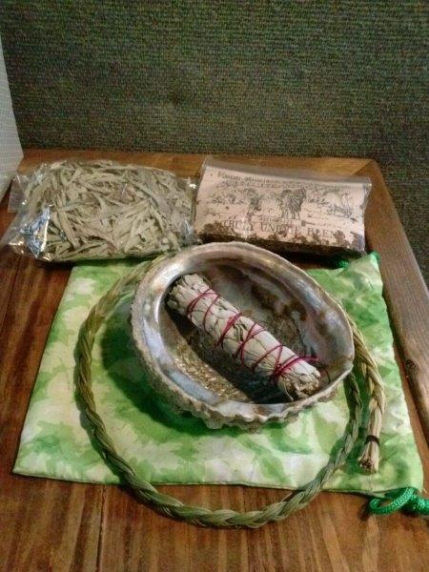
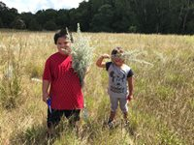
Bright Beginnings Recovery Support Program
Overview of program
The MAIC Bright Beginnings Recovery Support Program helps American Indian women who are pregnant or new moms who have a history of substance use disorder and child protection issues to achieve and maintain recovery in order to preserve the family. The program utilizes cultural teachings to engage families in supportive weekly groups and family activities.

Slide 3
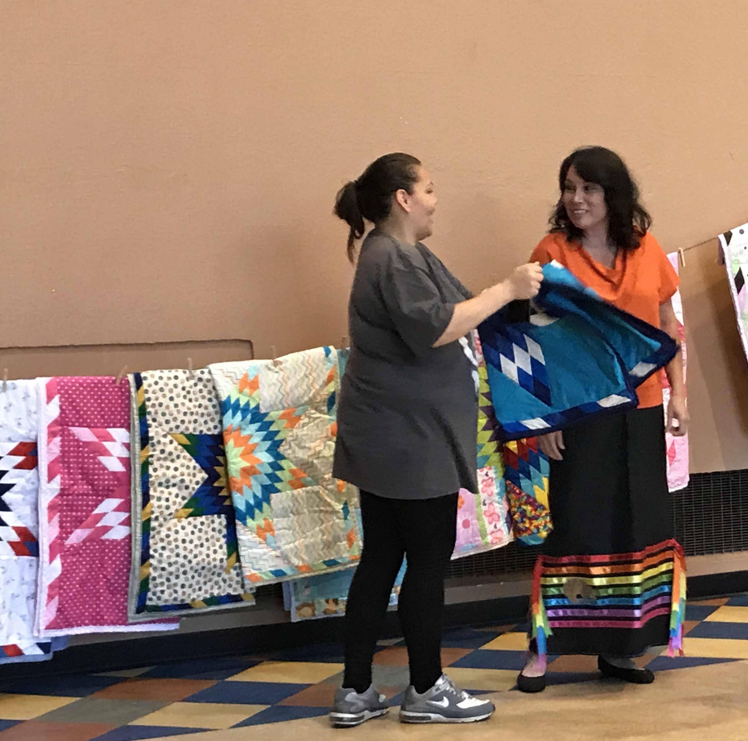
Services Provided
Case Management
Advocating
Cultural Support / Activities for Mothers and Babies
Collaboration / Networking with Service Providers
Weekly Support Groups
Home Visits
Transportation to Clinics / Appointments
Chemical Health Referrals/ Information
Stress Reducing Techniques for Mothers and Children

Slide 4
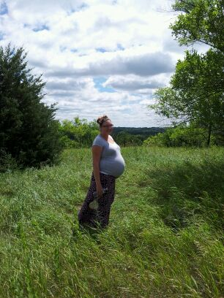
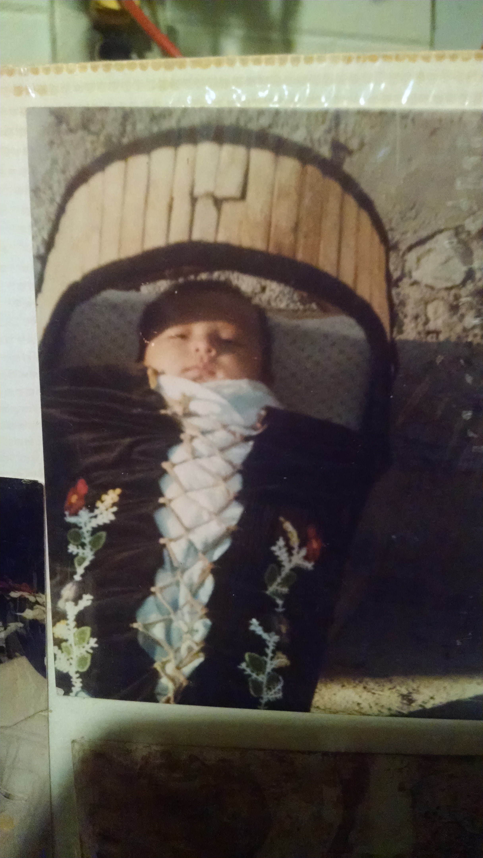
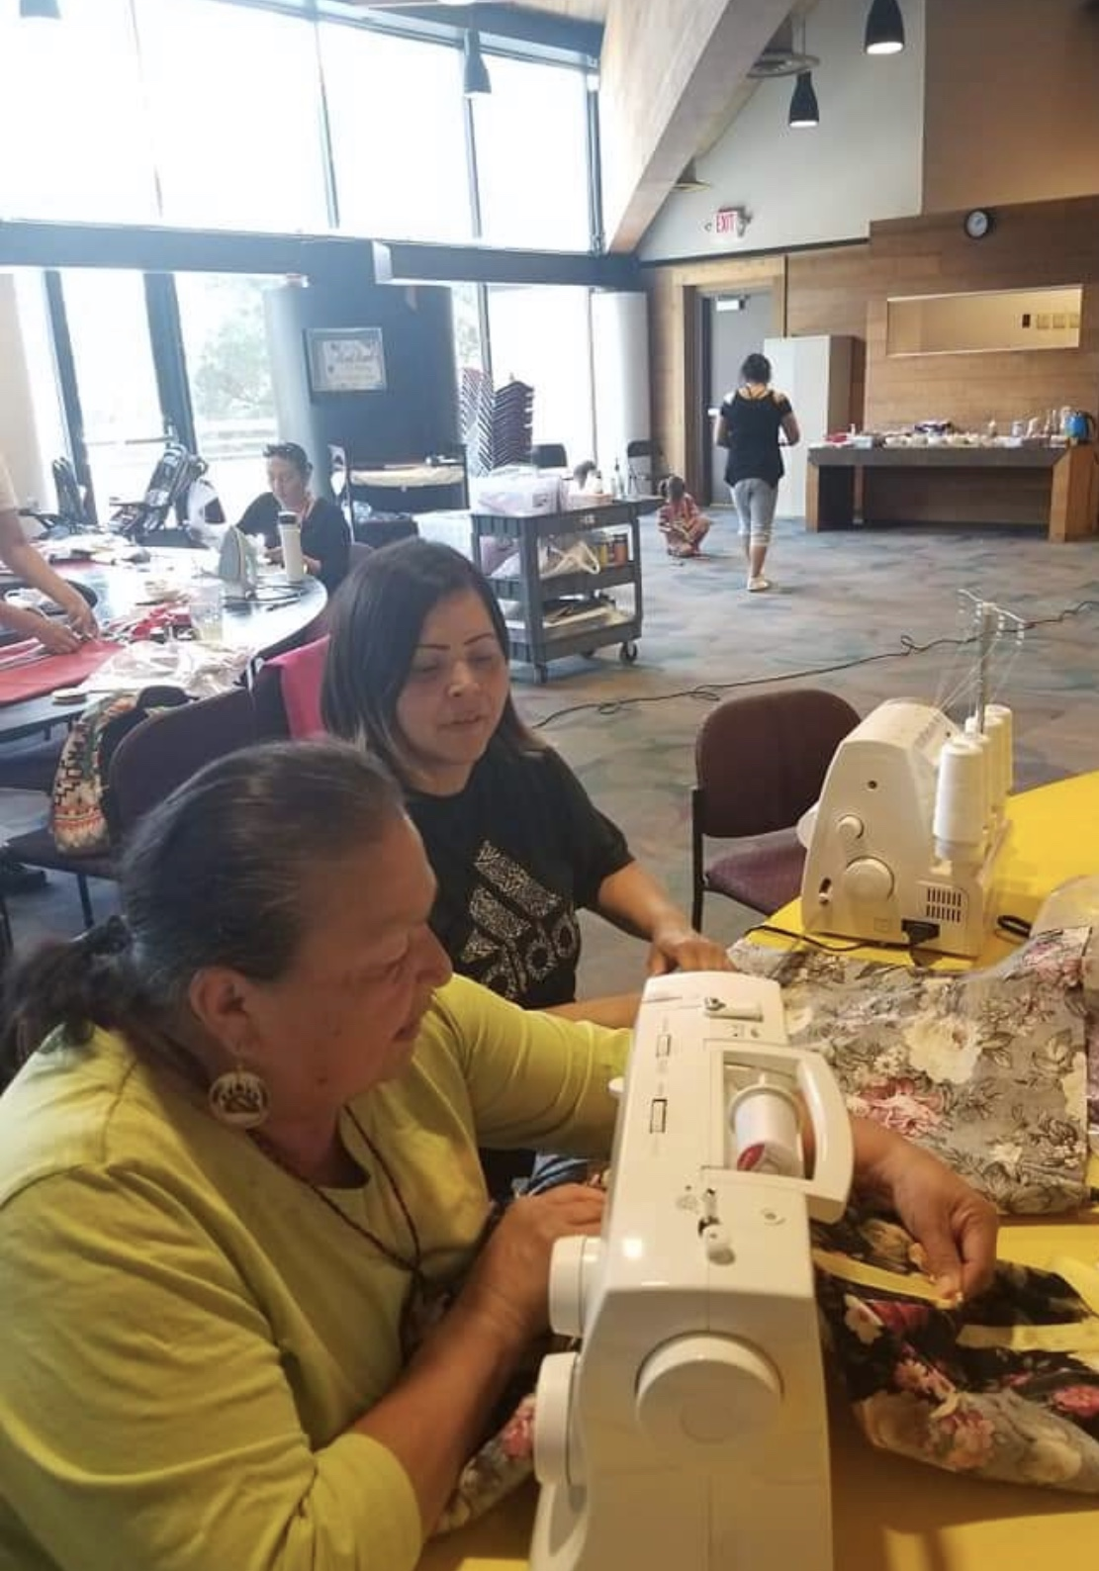
Cultural Teachings and Support
Notes:
This is example of healthy pregnancy, healthy children and healthy family, all learning together to be strong, resilient and keepers of our culture.

Slide 5
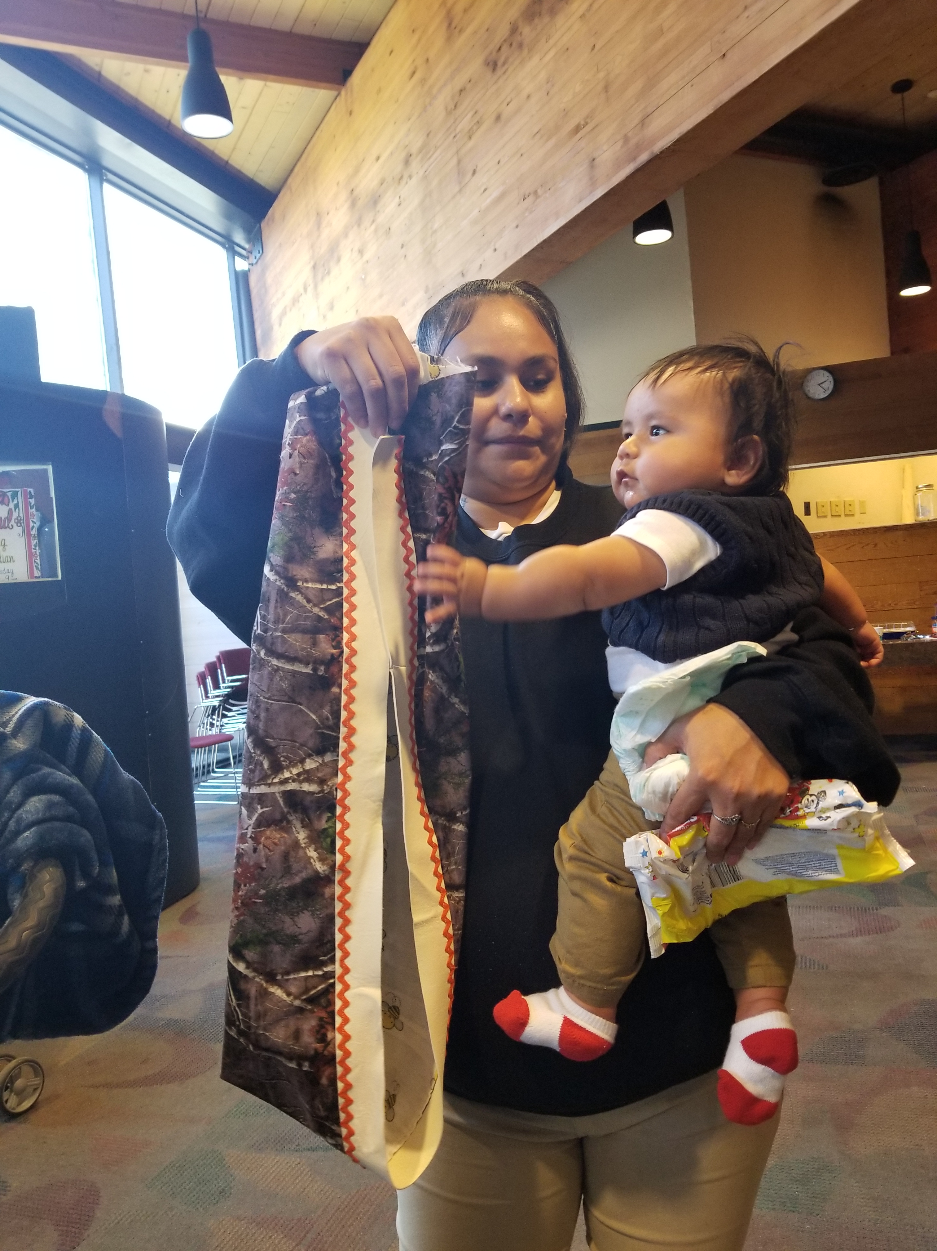
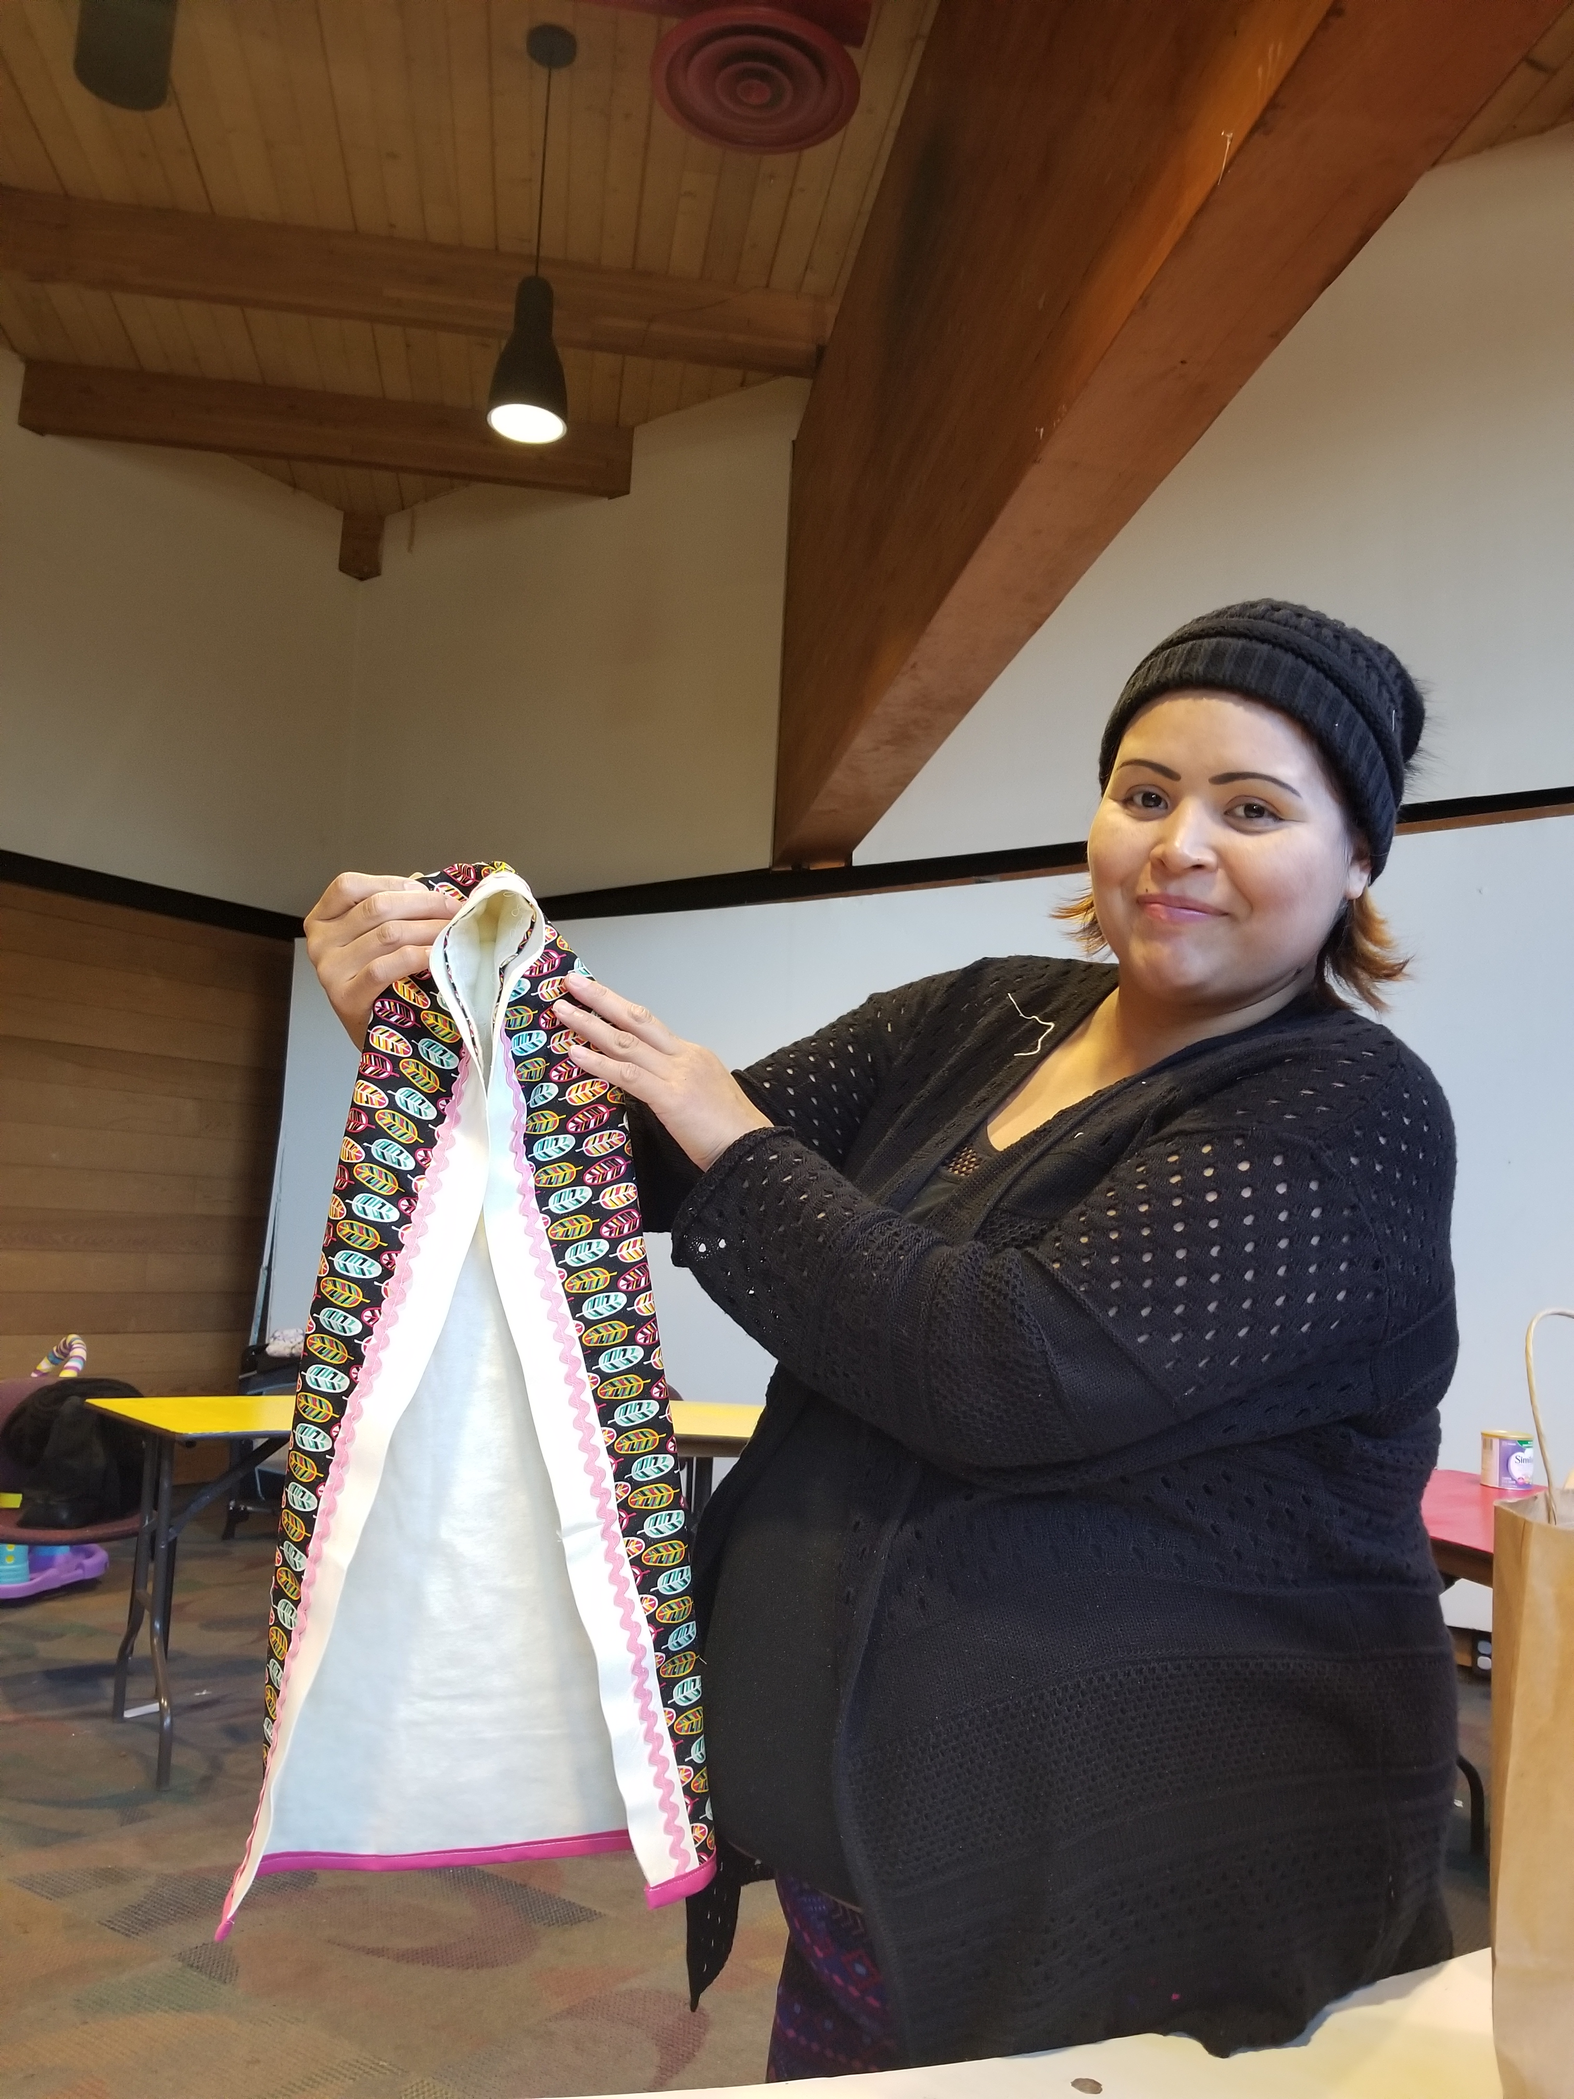
Baby Moss Bags

Slide 6
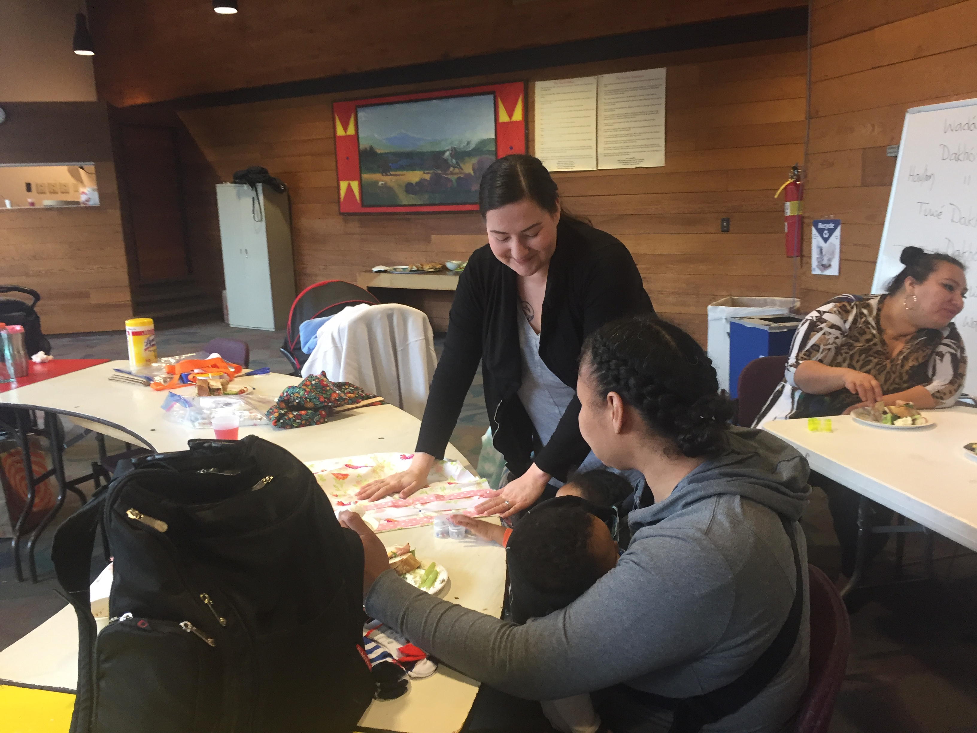
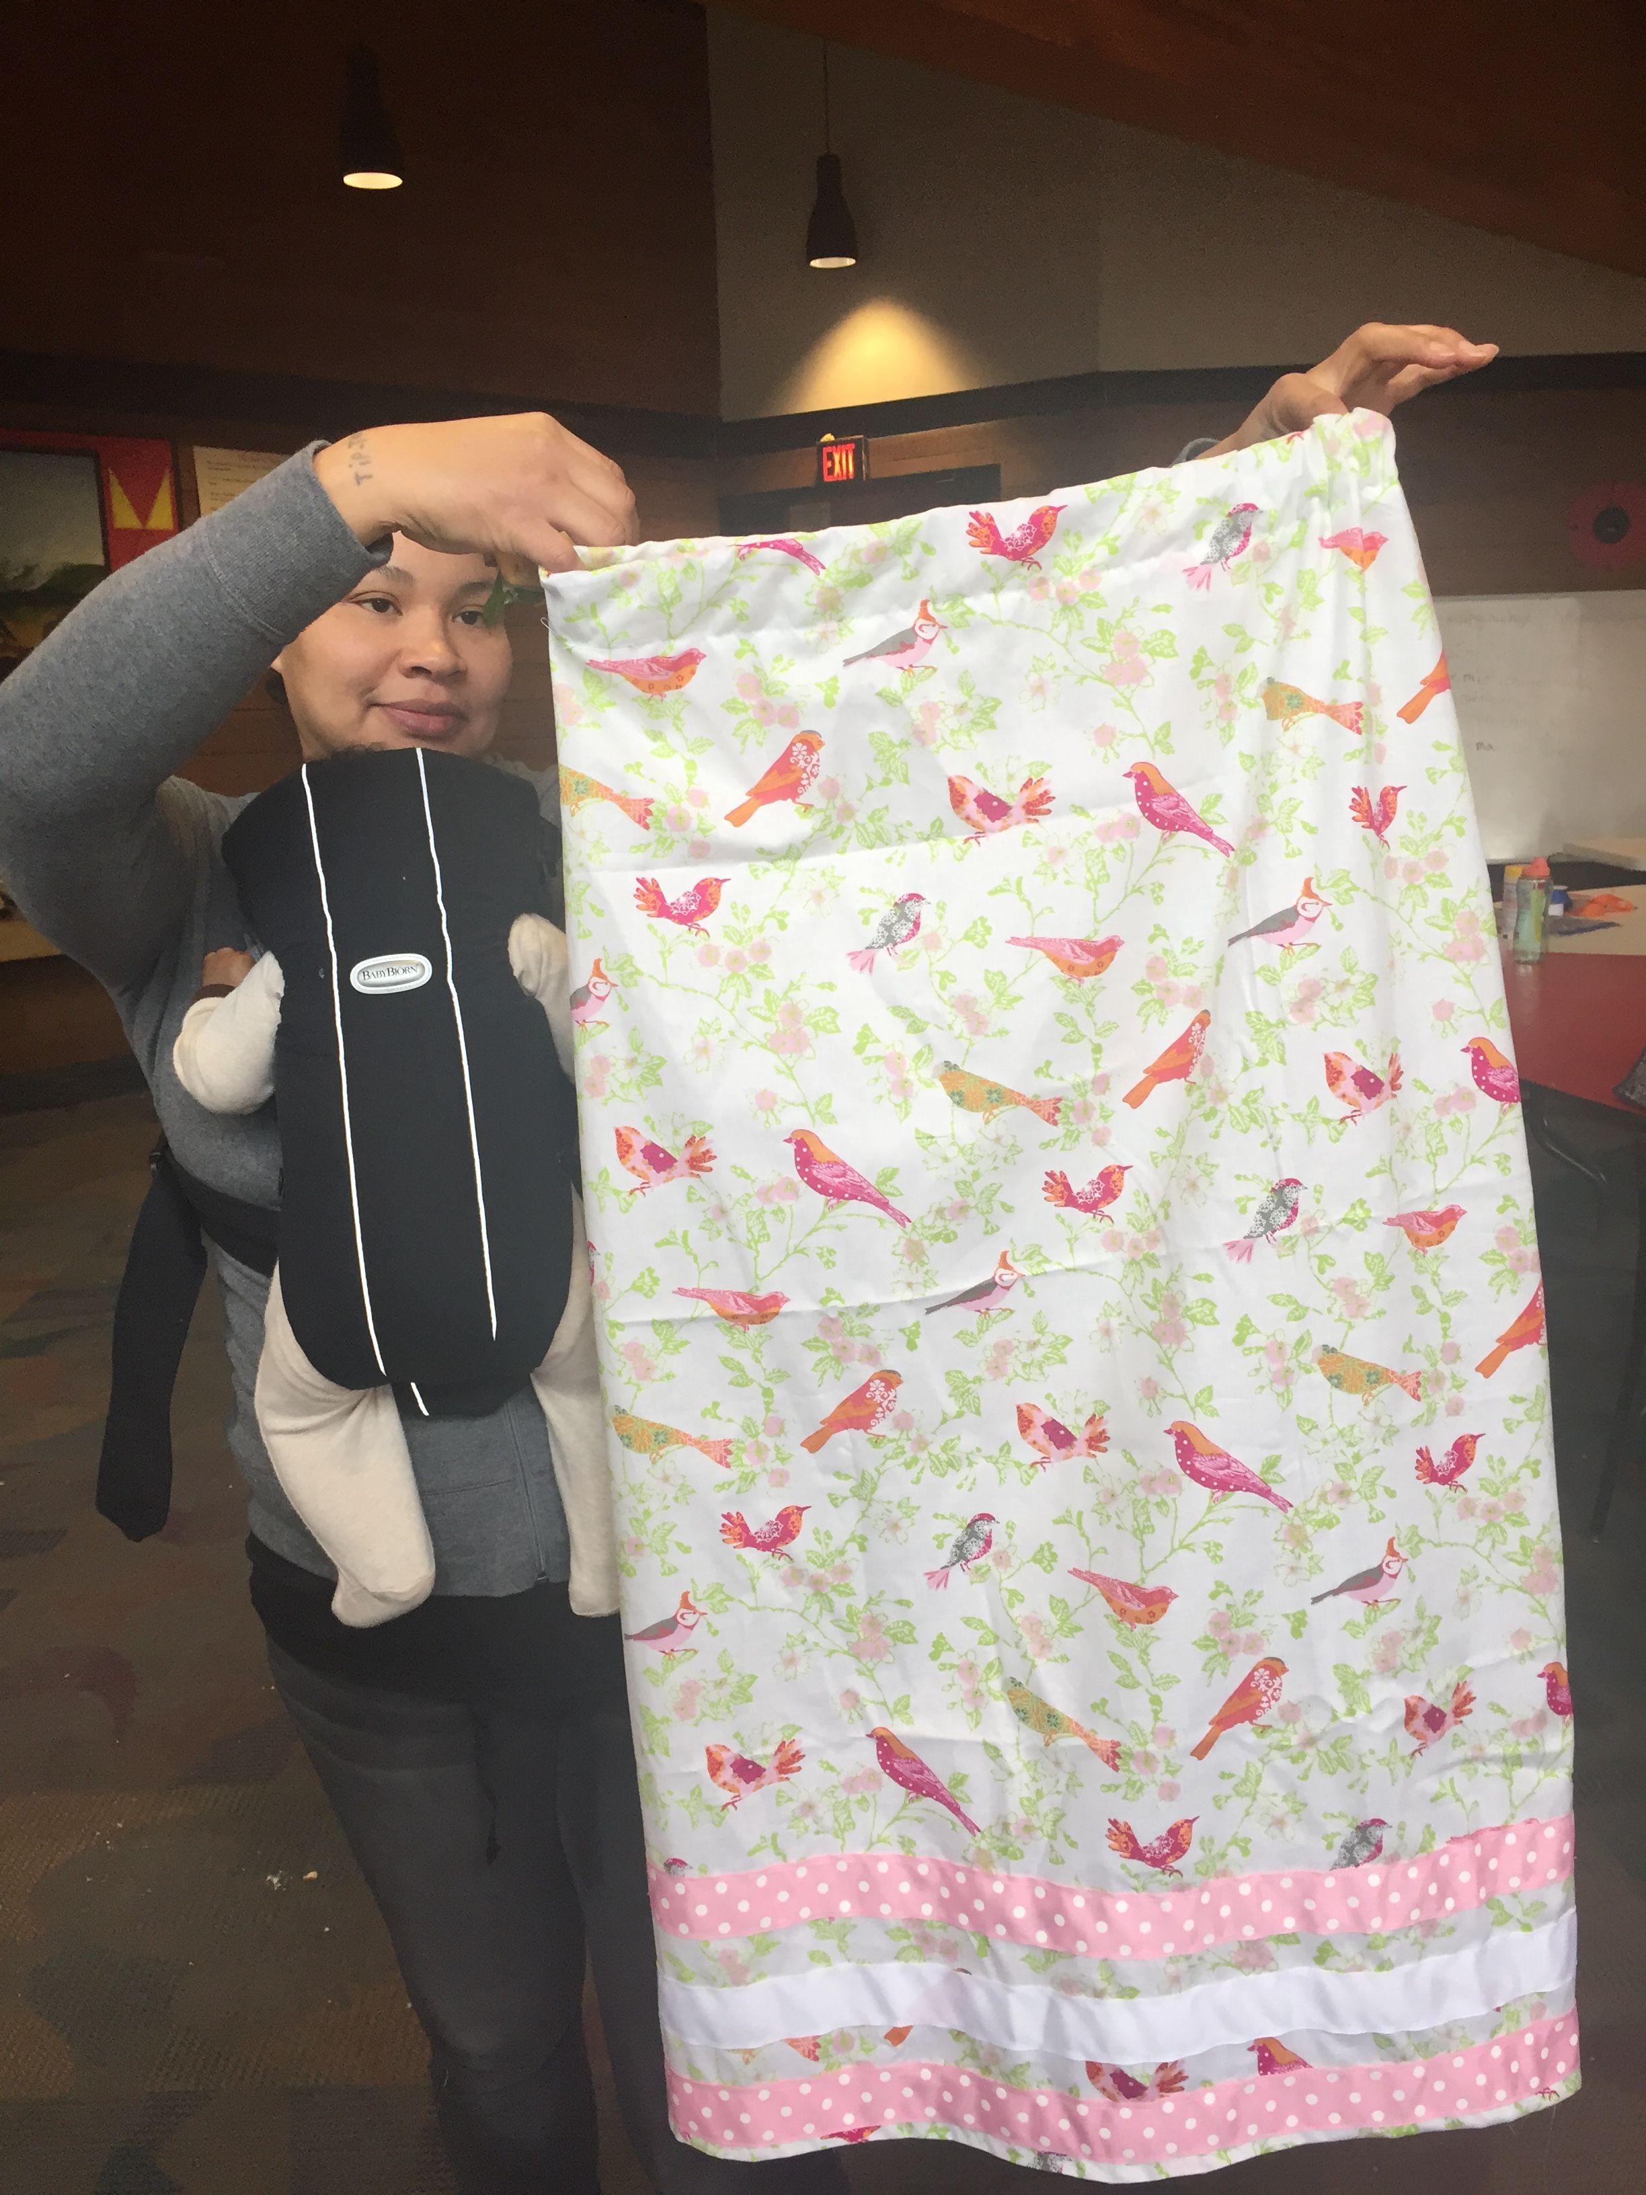
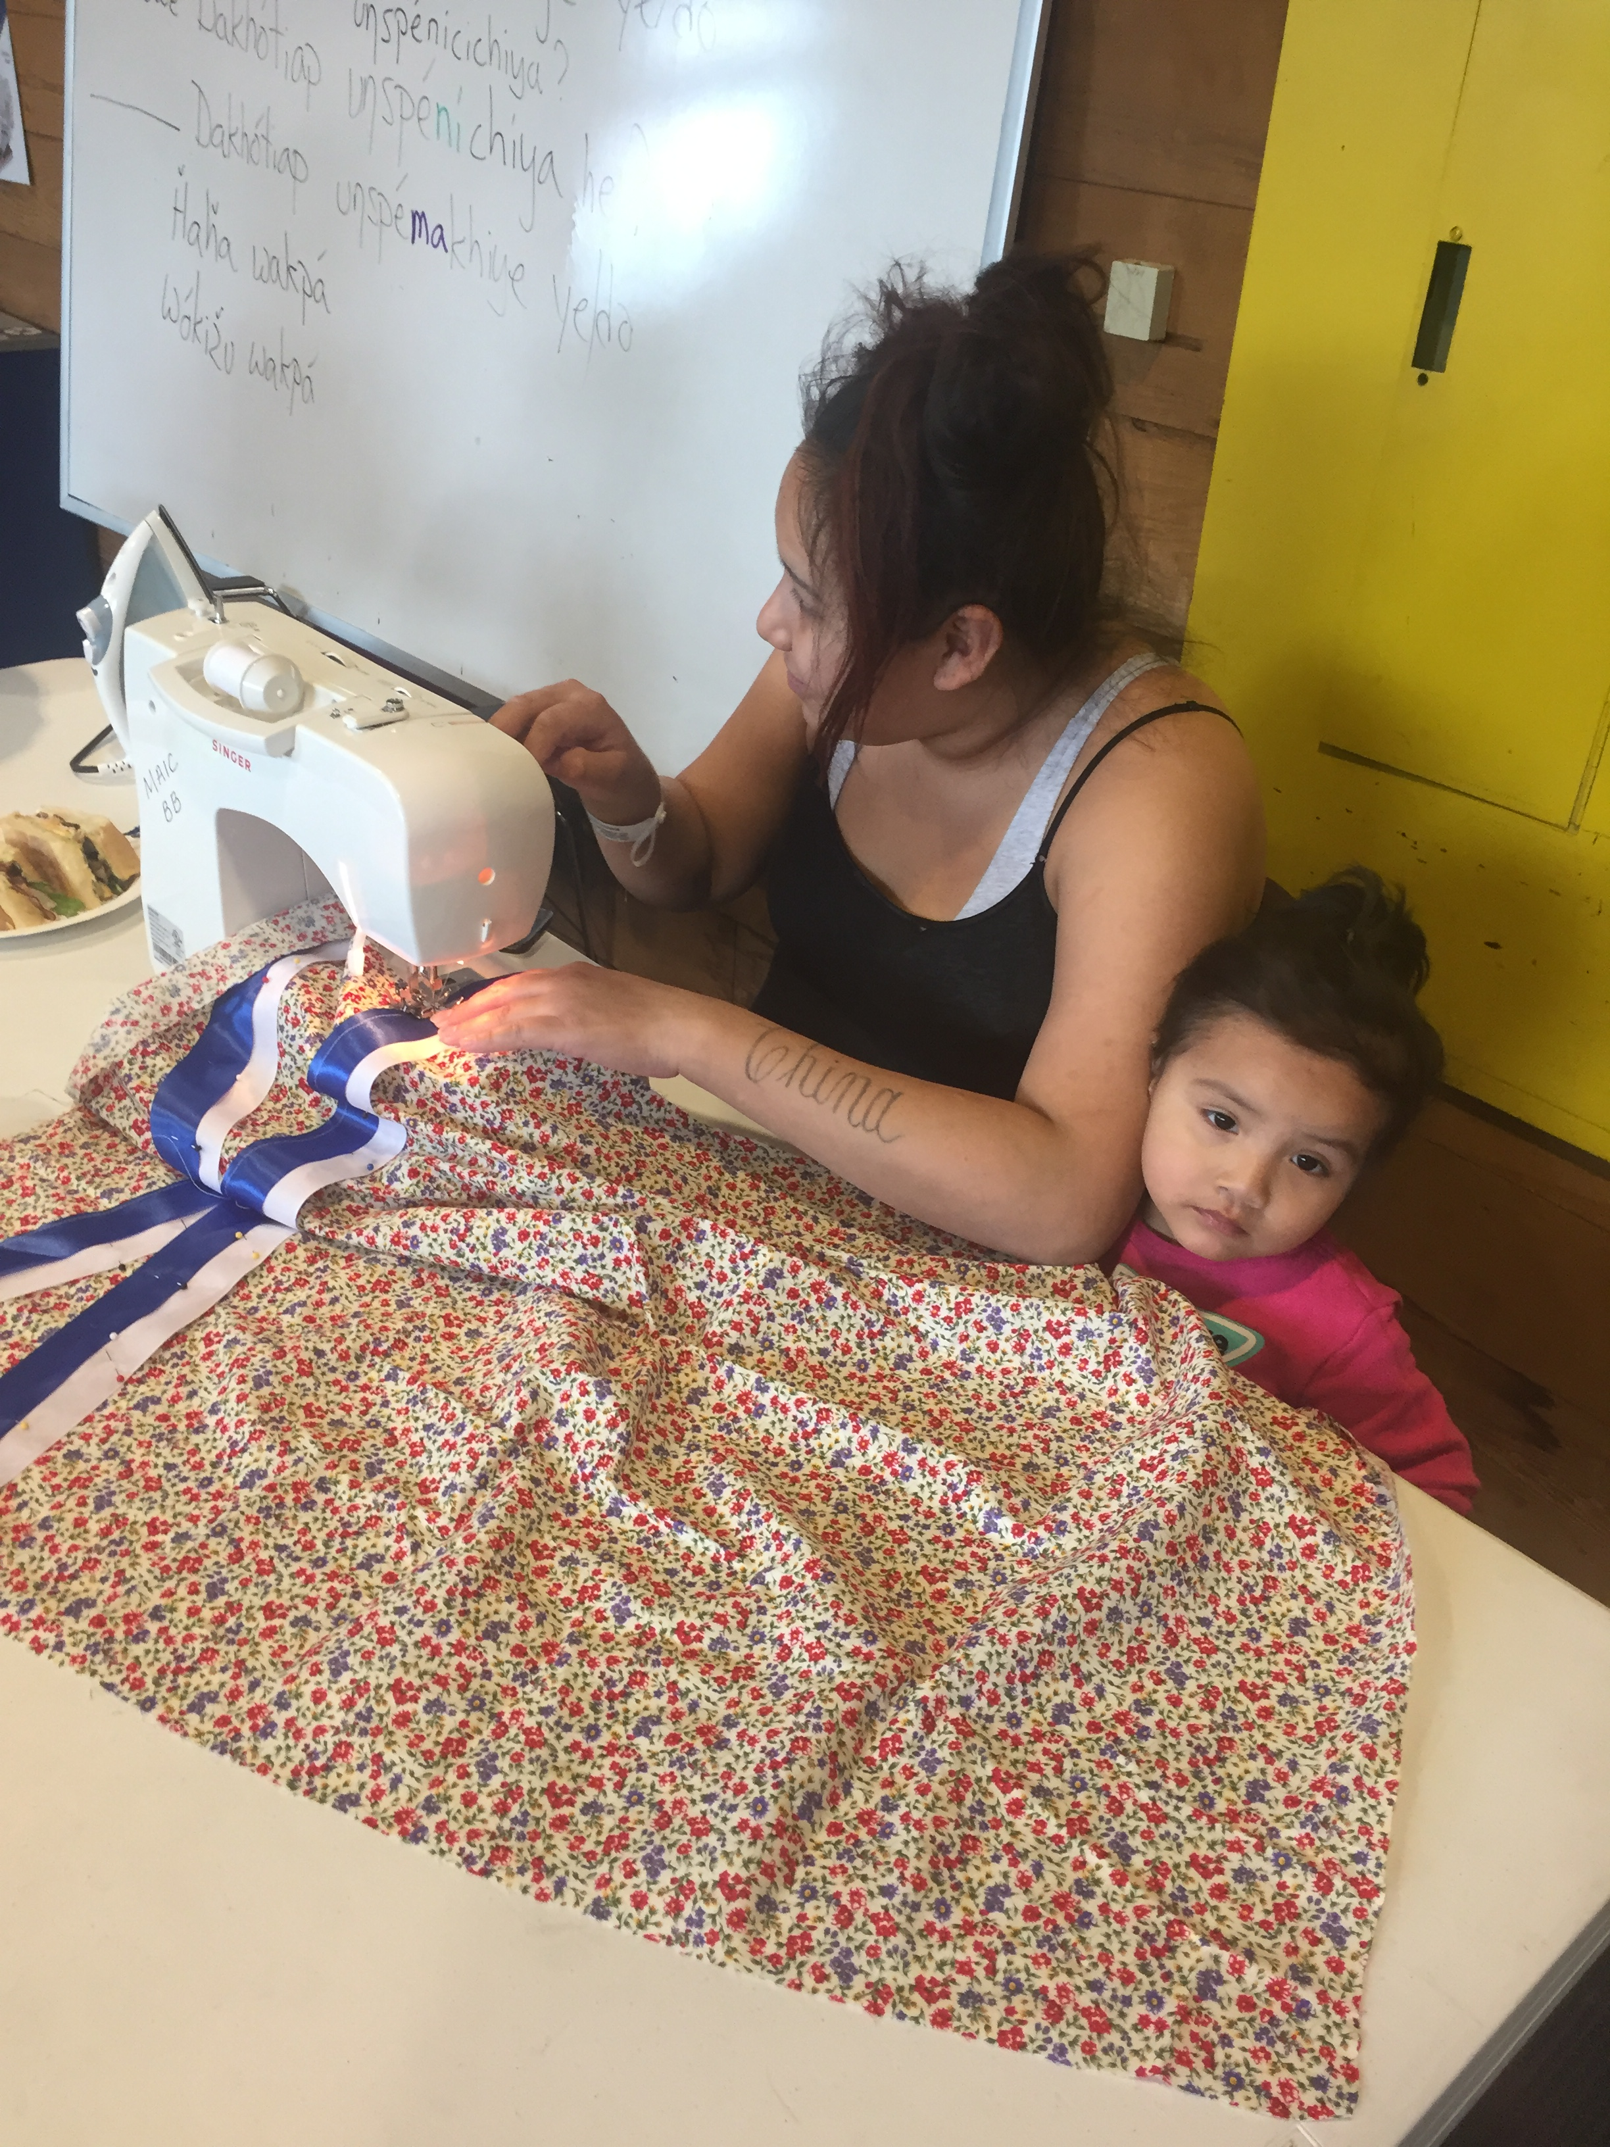
Ribbon Skirts

Slide 7
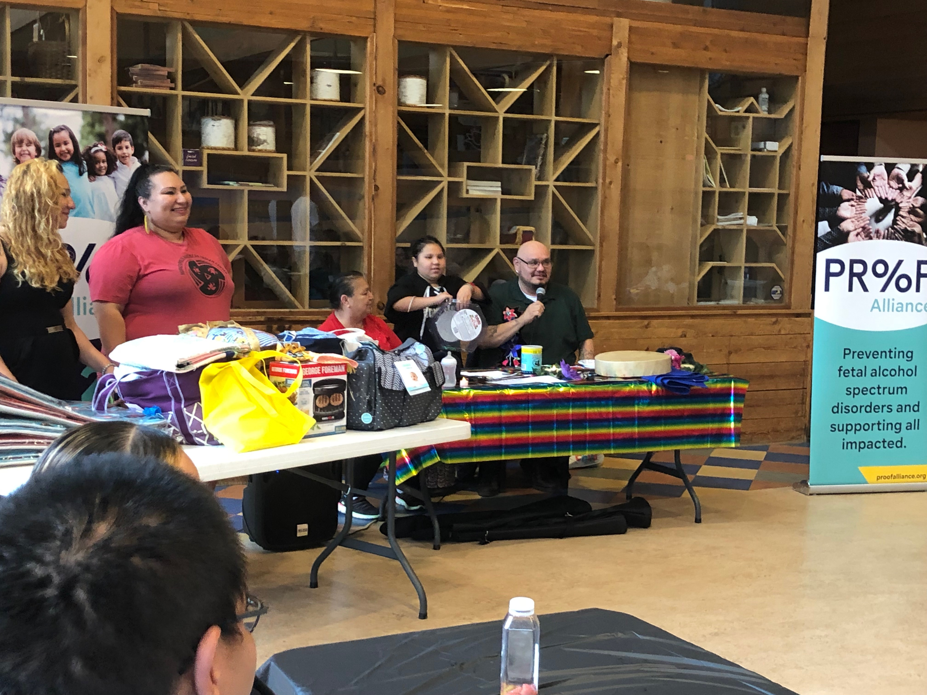
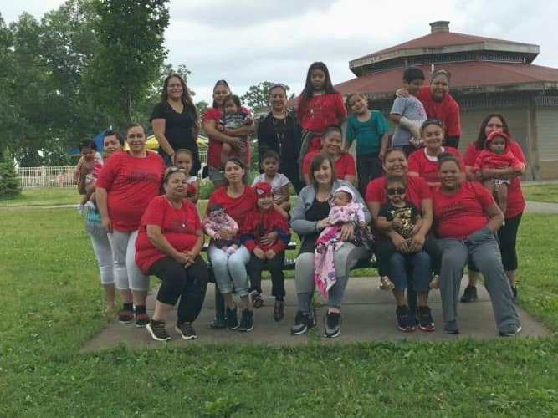
Group Events

Slide 8
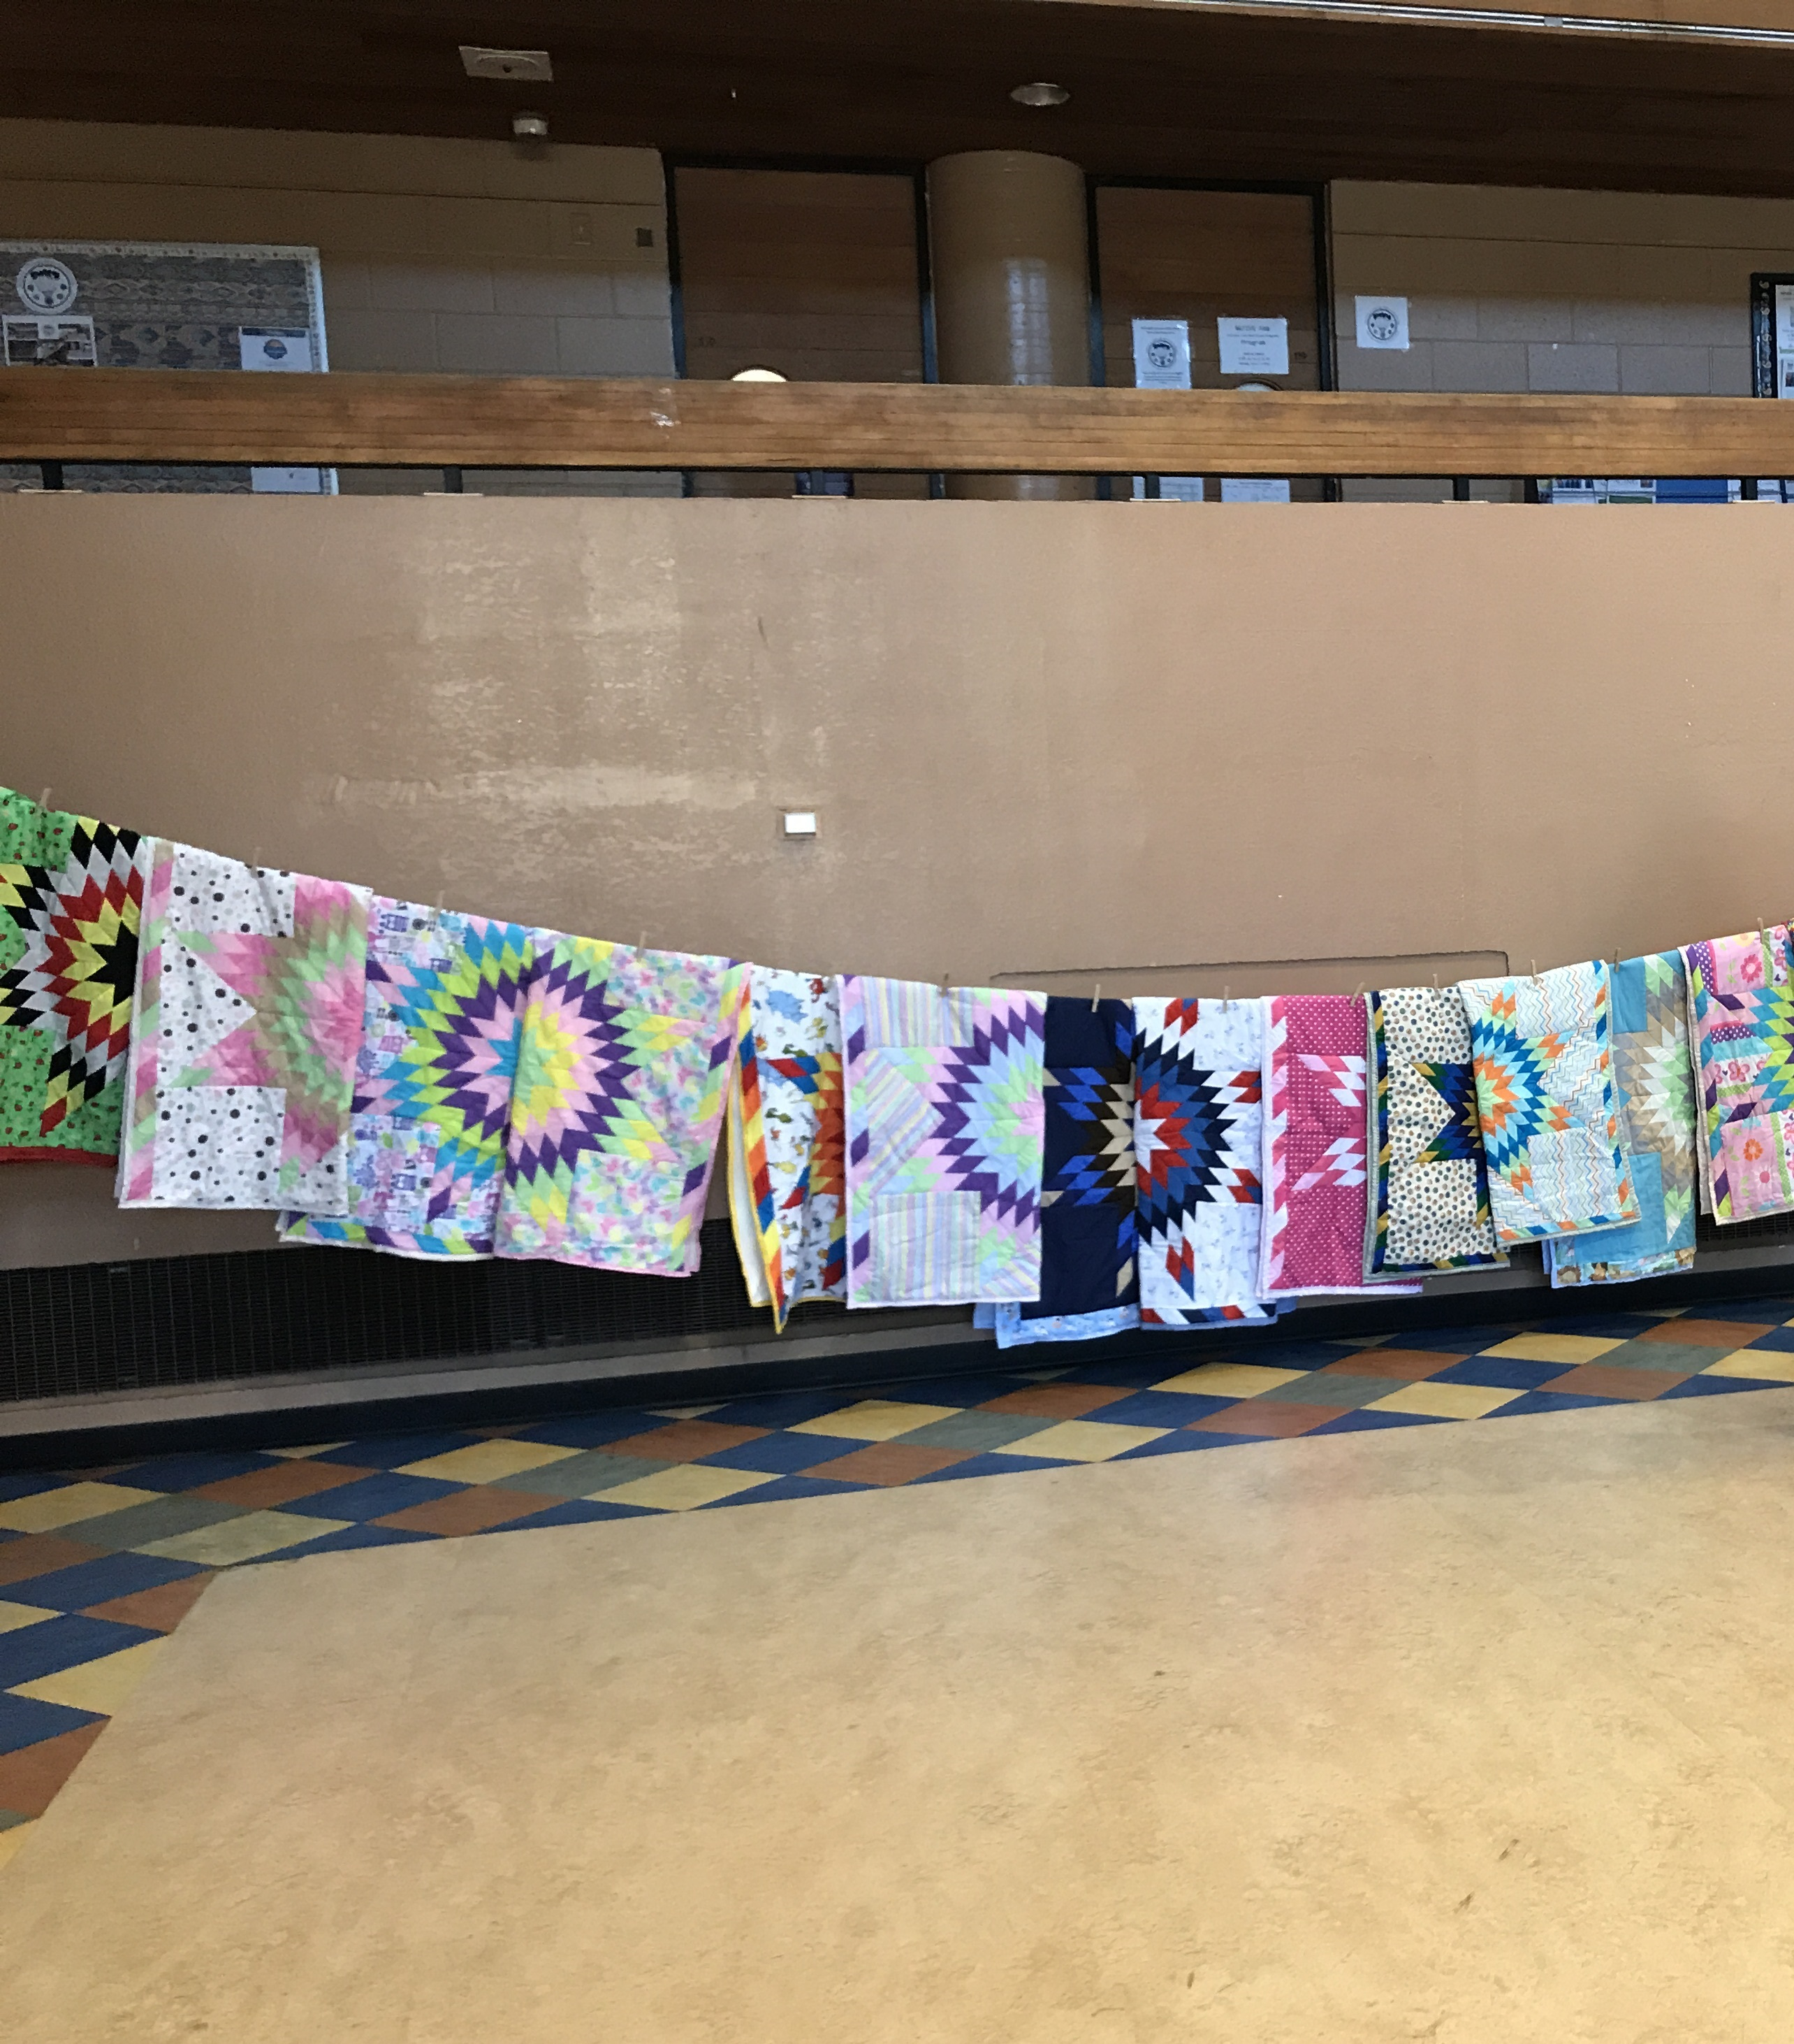
Staff
Laura Newton, WFS Coordinator
Jessy Beaulieu, BB Coordinator
Shavonnah Roberts, Case Manager
TBD, Case Manager

Slide 9
Core Teams:
Bright Beginnings families (inform process at each stage)
CORE Team Advising in collaboration with families: Child Welfare Cty Agency Admin, ICWA Law Center, Bright Beginnings staff, Tribal Representatives, White Earth Treatment Staff, Wayside House, Parent Mentors, etc.
Prenatal Core Team: Dr NACC Clinic, MIWRC staff, Henn Cty AI Community Liaison, DIW staff, Hospital staff HCMC, Early Childhood staff
Housing/SUD: Avivo, Wayside, AICDC, Community members, Family Shelter Housing Group,others TBD.
Child Welfare: Bring information, discuss proposed model and bring to attention of MUID Family Preservation Team. Work on identified data collection/data sharing needs.

Slide 10
Mother’s and Father’s voices: Call for Change
Parents spoke to us during a CORE group meeting with just BB staff and families about their experiences when they gave birth and the first interactions with hospital staff and child protection.
One mother said, “when I went to the hospital to give birth, I was in treatment doing ok, and was treated really badly when the hospital learned I was in a treatment program. Didn’t test positive for anything. Not a good birth experience because of that.”

Slide 11
Mother’s and Father’s voices: Call for Change
One Family’s story was especially memorable and influential in what we learned, a father described feeling watched the entire time they were in hospital. He said that things went well until after the birth when an Emergency Child Protection hold was placed on their newborn daughter. An investigation occurred because his partner had a child removed from her care previously that resulted in a transfer of legal custody. This had occurred in another relationship many years prior. This was his first child. His partner was on methadone but under care of doctors.
We heard many different stories all leading us to have discussion with County about how we could impact the Child Protection process when there is an investigation at birth.

Slide 12
WFS Bright Beginnings Pilot Project with Hennepin Co.
Document policies and practices employed by Hennepin County currently that relate to the prevention of and the removal of infants from their families as Children in Need of Protection and Services
Develop data sharing agreements with Hennepin County for regular provision of information on Native families/children in the child welfare system.

Slide 13
Pilot Project
Hennepin County Child Protection Investigators and Bright Beginnings Coordinator will connect on cases that either screened in for services and investigation. Bright Beginnings staff are willing to come in to the case as a helper to the family in identifying relative caregivers, helping to create a safety plan and conducting intake and admittance into the program.
Bright Beginnings/ HC County Pilot cases will be identified as being eligible for the pilot by the following factors:
Native American parent who has recently given birth or is currently pregnant and is either screened in for services case or investigation.
Hennepin County will notify BB Coordinator to attend meeting at the hospital during/after investigative interview (to be determined if BB would sit in on mtg)
If a Critical Response meeting is planned Bright Beginnings will assist in helping to contact family, service providers etc.

Slide 14
Pilot Project Numbers
Pilot Project will work with the first 10 families that fit criteria (investigation in Child Protection beginning just prior to and at birth or very soon afterward, family identifies as being Native American, family wants to participate in services).
Bright Beginnings Case Manager will work with investigator and family at hospital if possible and work on meeting as part of a CP Crisis Response Safety Planning. If determined that a safety plan can not be put in place for child to remain out of home BB will stay involved and continue forward on case.
Bright Beginnings will report quarterly to Hennepin County the number of calls, referrals and contacts that occur between Child Protection and Bright Beginnings, and the number of cases that Bright Beginnings works with jointly, and after the initial investigation. Data will be shared on the outcome of each family’s progress each quarter.
After 10 families have been through the Pilot Project Bright Beginnings and Hennepin County CP Investigation Team will meet to review progress and determine additional need, changes etc.

Slide 15
Other Identified Areas for Change
Changes to Hospital Care
WFS BB video of mothers stories to be presented to hospital staff as training/discussion
WFS BB identified Prenatal Core Team will meet with stakeholders in hospital settings with video
WFS BB families identified Housing/lack of safe suitable housing for families in recovery and for pregnant women as essential needs that are lacking and if they had earlier could have impacted their case plan
WFS BB families identified the need for culturally supportive treatment for moms both outpatient and with housing.
WFS BB will work with consultant on housing policy and convening Core Team

Slide 16
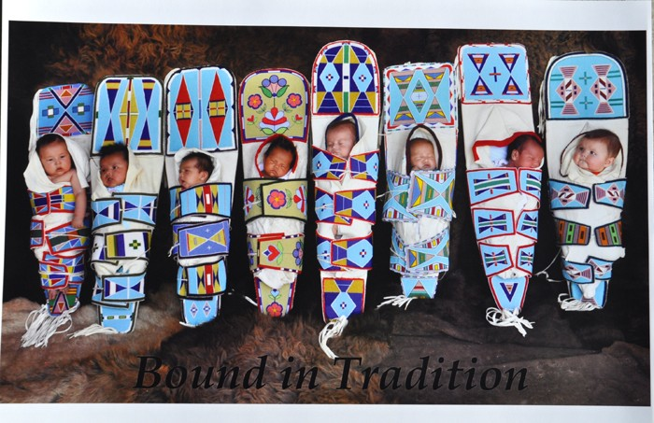
Minneapolis American Indian Center
WFS/Bright Beginnings Recovery Support Program
Miigwech…..Lila Pilamaya…..Pinigigi…..Gracias

