Slide 1
MinnesotaCare: A healthier state for more people

Slide 2
Why is health insurance important?
Health insurance helps you
Be your healthiest
Live your life to the fullest
Get ahead
Avoid high costs in case of illness or injury
Notes:
Health insurance helps you be your healthiest and live your life to the fullest. It can help you get ahead. It also protects you from high costs in case of illness or injury.
Everyone who lives in Minnesota deserves the peace of mind that comes with health insurance.

Slide 3
MinnesotaCare covers
Doctor visits
Dental care
Emergency care
Mental and behavioral health care
Eye exams and eyeglasses
Pregnancy care and doulas
Substance use disorder treatment
Translations and interpreters
Chiropractic medicine and acupuncture
Medicine and prescription drugs
Medical supplies
Wellness checkups, vaccines and immunizations
Notes:
MinnesotaCare offers comprehensive health insurance to people who live in the state who cannot afford private or employer-sponsored insurance. It’s free or lower cost health insurance for people without other health insurance who live in Minnesota.
MinnesotaCare has been around for more than 30 years. It was created by Minnesotans, for Minnesotans.
MinnesotaCare helps you pay for health care services, like those shown on the screen (read through list).

Slide 4
Who is eligible?
Live in Minnesota.
Meet the income limits.
Lack other health insurance options.
Notes:
More Minnesotans can now access MinnesotaCare. Beginning in 2025, MinnesotaCare is available to Minnesotans regardless of their immigration status. Applicants must meet income limits and other rules.
You are eligible for MinnesotaCare if you
Live in Minnesota.
Meet the income limits.
Lack other health insurance options. If your job offers you health insurance, you may still qualify if the insurance from your job is too expensive for you.
If you meet these requirements, you should apply.

Slide 5
Income limits
Household size | 1 person | 2 people | 3 people | 4 people | 5 people | 6 people | 7 people | 8 people
Annual income | $30,120 or less | $40,880 or less | $51,640 or less | $62,400 or less | $73,160 or less | $83,920 or less | $94,680 or less | $105,440 or less
Notes:
This chart shows the income limits for MinnesotaCare. The limits depend on the number of people in your household. For example, the income limit for 1 person is $30,120 a year. The income limit for a family of four is $62,400.
People applying for MinnesotaCare must provide proof that they meet the income limits. Proof can include paystubs or bank statements. Or applicants can sign a legal document attesting to meeting the income limits.

Slide 6
How much does it cost: premium bills
Household size | 1 person | 2 people | 3 people | 4 people | 5 people | 6 people | 7 people | 8 people | Monthly premium
Annual income | Up to $24,095 | Up to $32,703 | Up to $41,311 | Up to $49,919 | Up to $58,527 | Up to $67,135 | Up to $75,743 | Up to $84,351 | $0
Annual income | Up to $25,601 | Up to $34,747 | Up to $43,893 | Up to $53,039 | Up to $62,185 | Up to $71,331 | Up to $80,477 | Up to $89,623 | $4*
Annual income | Up to $27,107 | Up to $36,791 | Up to $46,475 | Up to $56,159 | Up to $65,843 | Up to $75,527 | Up to $85,211 | Up to $94,895 | $9*
Annual income | Up to $28,613 | Up to $38,835 | Up to $49,057 | Up to $59,279 | Up to $69,501 | Up to $79,723 | Up to $89,945 | Up to $100,167 | $15*
Annual income | Up to $30,119 | Up to $40,879 | Up to $51,639 | Up to $62,399 | Up to $73,159 | Up to $83,919 | Up to $94,679 | Up to $105,439 | $21*
*Multiply by number of people in household enrolled in MinnesotaCare for total bill amount.
Notes:
Some MinnesotaCare members pay a monthly bill, called a premium, for their insurance. The bill amount depends on your income, family size and the number of family members enrolled in the program.
Some people never have to pay a premium:
Children younger than 21.
American Indians and Alaskan Natives and their families.
Military members and their families for 12 months if they became eligible within 24 months after completing active duty.
After you apply, you will be told if you qualify for MinnesotaCare. You then need to pay your first monthly premium for your insurance to begin.
Monthly premiums have been temporarily lowered through December 2025 due to a federal law during COVID-19. Many people will pay no monthly premium until the premiums return to previous amounts in 2026.

Slide 7
How much does it cost: copays
MinnesotaCare copays:
$0 for preventive care, such as annual checkups, cancer screenings and vaccinations
$0 for outpatient surgery
$0 for durable medical equipment, like wheelchairs, walkers, oxygen equipment or blood-testing strips for diabetes
$0 for dental visits
$0 for mental health medicines
$25 for brand-name medicines or $10 for generic medicines with a maximum of $70 per month
$28 for doctor-office visits
$100 for emergency room visits ($0 copay if ER visit leads to hospitalization)
$250 for inpatient hospital admission
$45 per visit for radiology services, like X-rays
$10 per pair of eyeglasses
Some people never have copays:
Children younger than 21 years old
Pregnant people
American Indians enrolled in a federally recognized Tribe
American Indians who receive services from an Indian health care provider or through a referral from the Indian Health Services (IHS) Contract Health Services
Notes:
Some MinnesotaCare members need to pay part of their medical bills. This cost sharing is called a copay. It is a fixed amount your pay out of pocket for a specific health care service.
Some people never have copays:
Children younger than 21 years old
Pregnant people
American Indians enrolled in a federally recognized Tribe
American Indians who receive services from an Indian health care provider or through a referral from the Indian Health Services (IHS) Contract Health Services
MinnesotaCare covers a broad range of services for preventive care, routine care, specialty care and emergency care. Most services do not have a copay. For example:
$0 for preventive care, such as annual checkups, cancer screenings and vaccinations
$0 for outpatient surgery
$0 for durable medical equipment, like wheelchairs, walkers, oxygen equipment or blood-testing strips for diabetes
$0 for dental visits
$0 for mental health medicines
MinnesotaCare copays:
$25 for brand-name medicines or $10 for generic medicines with a maximum of $70 per month
$28 for doctor-office visits
$100 for emergency room visits ($0 copay if ER visit leads to hospitalization)
$250 for inpatient hospital admission
$45 per visit for radiology services, like X-rays
$10 per pair of eyeglasses
You pay your copay directly to your health care provider. Some providers make you pay the copay before you receive care.
Those are the only costs MinnesotaCare members pay for covered services. MinnesotaCare members have no deductible. (Deductibles are required amounts you must pay out of pocket before the insurance pay for your medical bills.)

Slide 8
How to apply
You can apply 24/7/365
One-on-one help from a navigator in your community
Online
Paper form
Notes:
You can apply for MinnesotaCare at any time during the year. There is no deadline to apply. There are no limits on the number of people who may enroll .
Choose the easiest way for you to apply:
One-on-one help: Get free help from an expert in your community. Navigators walk you through the process. They also answer your questions. Find a navigator who speaks your language at mnsure.org/free-help. You can also call 651-539-2099 or 855-366-7873 for help in your language.
Online: Apply online at mnsure.org. You will need to register for an account, or sign in if you already have one. Note: If your children or other family members are already enrolled in Medical Assistance or MinnesotaCare, do not submit a new application. Call a navigator or your county for help.
Paper form: Fill out the paper application, and submit it to your county. You can find applications on our website at mn.gov/dhs/MinnesotaCare, through a navigator or at your county office.
To help you get MinnesotaCare started as quickly as possible:
Be thorough and complete in your application.
Answer requests for more information immediately.
Pay your premium immediately.

Slide 9
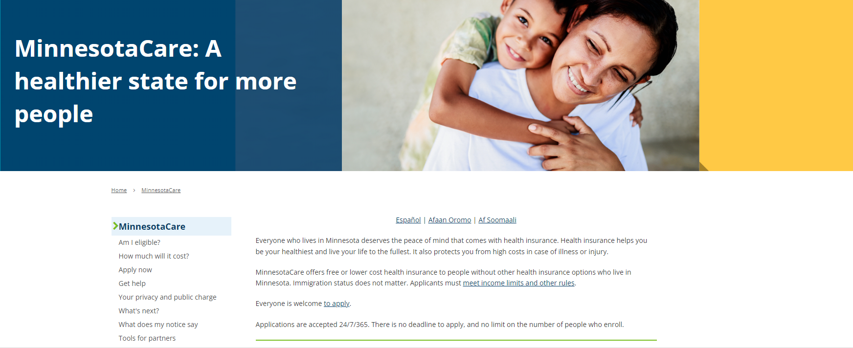
Your online resource: mn.gov/dhs/MinnesotaCare
Notes:
We’ve created a one-stop shop for all things MinnesotaCare at mn.gov/dhs/MinnesotaCare. This website provides you with all the information you need and is available in English, Spanish, Somali and Oromo.
Learn about eligibility rules and how much you’ll have to pay for your insurance and health care services. You can apply online or get help with your application. Learn about what happens next after you get approved for MinnesotaCare. Get answers to frequently asked questions. And get translated versions of notices you may receive in the mail.

Slide 10
Examples of people who may qualify
Carlos is 67.
He lives in Minnesota after entering the United States without authorization. He has no immigration papers.
He is not married and has no children.
He makes $1,500 a month, or $18,000 a year.
He is uninsured, and his job doesn’t offer health insurance.
Next step: Complete an application.
Notes:
Carlos is 67.
He lives in Minnesota after entering the United States without authorization. He has no immigration papers.
He is not married and has no children.
He makes $1,500 a month, or $18,000 a year.
He is uninsured, and his job doesn’t offer health insurance.
Next step: Complete an application. Visit mn.gov/dhs/MinnesotaCare to find a navigator to help you apply with free one-on-one help. Or learn how to apply online on the website or find paper applications to print out

Slide 11
Examples of people who may qualify
Fatima and Ibrahim are both 45.
They live in Minnesota and neither has immigration papers.
They are married and have two children, who are both U.S. citizens and already receive Medical Assistance coverage.
Their household income is $60,000 a year.
Their employers do not offer health insurance they can afford.
Next step: Call a navigator or your county for help requesting insurance for Fatima and Ibrahim. Do not apply online – you already have a case in the system for your children’s insurance.
Notes:
Fatima and Ibrahim are both 45.
They live in Minnesota and neither has immigration papers.
They are married and have two children, who are both U.S. citizens and already receive Medical Assistance coverage.
Their household income is $60,000 a year.
Their employers do not offer health insurance they can afford.
Next step: Call a navigator or your county for help requesting insurance for the parents. Do not apply online – you already have a case in the system for your children’s insurance.
Some people who newly qualify for MinnesotaCare may have an immediate family member like a child already enrolled in MinnesotaCare. Or the child may already be enrolled in Medical Assistance, which is another insurance program for low-income Minnesotans.
When a person who wants MinnesotaCare has an immediate family member, such as a spouse or child, who is already enrolled in Medical Assistance or MinnesotaCare, the person will not need to submit an application for MinnesotaCare. They already have a case started. The person should contact their county or a navigator for help. Because we already have basic information about their household, they do not need to provide an entire application of information. And in fact submitting another application may create problems and delays in getting insurance. Again, people with an immediate family member on Medical Assistance should NOT submit an application for MinnesotaCare. They should also not apply online. They should contact their county or a navigator for help.

Slide 12
Examples of people who may qualify
Paul and Nadine are both 26.
They live in Minnesota and neither has immigration papers.
They are married and have two children, who are both U.S. citizens.
They make $62,000 a year.
Their employers do not offer health insurance they can afford for their family. No one in the family has health insurance.
Next step: Complete an application for all four family members.
Notes:
Paul and Nadine are both 26.
They live in Minnesota and neither has immigration papers.
They are married and have two children, who are both U.S. citizens.
They make $62,000 a year.
Their employers do not offer health insurance they can afford for their family.
Next step: Complete an application for all four family members.

Slide 13
Examples of people who may qualify
Amari is 21.
They live in Minnesota after coming to the United States on a Visa, which has expired. They stayed in the country and have no immigration papers.
They make $2,500 a month, or $30,000 a year.
Next step: Complete an application.
Notes:
Amari is 21.
They live in Minnesota after coming to the United States on a Visa, which has expired. They stayed in the country and have no immigration papers.
They make $2,500 a month, or $30,000 a year.
Next step: Complete an application .

Slide 14
Examples of people who may qualify
Ana is 35.
She lives in Minnesota and is a Deferred Action for Childhood Arrivals (DACA) recipient.
She is not married and has no children.
She makes $2,500 a month, or $30,000 a year.
She is uninsured, and her job doesn’t offer insurance.
Next step: Complete an application following DACA application process. (DACA recipients have been eligible for MinnesotaCare since 2017 and follow a different application process.)
Notes:
Ana is 35.
She lives in Minnesota and is a Deferred Action for Childhood Arrivals (DACA) recipient.
She is not married and has no children.
She makes $2,500 a month, or $30,000 a year.
She is uninsured, and her job doesn’t offer insurance.
Next step: DACA recipients have been eligible for MinnesotaCare since 2017 and follow a different application process.

Slide 15
Examples of people who may qualify
Maria is 32.
She lives in Minnesota and has applied for asylum, but has not yet received employment authorization.
She has a 10-year-old child whose application for asylum has been pending for less than 180 days.
She is currently self-employed and earns $27,000 annually.
Her and her child have no health insurance.
Next step: Complete an application.
Once Maria receives employment authorization and her child’s application for asylum has been pending for 180 days, they should report the changes to the Department of Human Services Health Care Consumer Support team. Her child may be eligible for Medical Assistance. She can work with the state to move her child from MinnesotaCare to Medical Assistance if eligible.
Notes:
Maria is 32.
She lives in Minnesota and has applied for asylum, but has not yet received employment authorization.
She has a 10-year-old child whose application for asylum has been pending for less than 180 days.
She is currently self-employed and earns $27,000 annually.
Her and her child have no health insurance.
Next step: Maria should complete an application .
Once Maria receives employment authorization and her child’s application for asylum has been pending for 180 days, they should report the changes to the Department of Human Services Health Care Consumer Support team. Her child may be eligible for Medical Assistance. She can work with the state to move her child from MinnesotaCare to Medical Assistance if eligible.

Slide 16
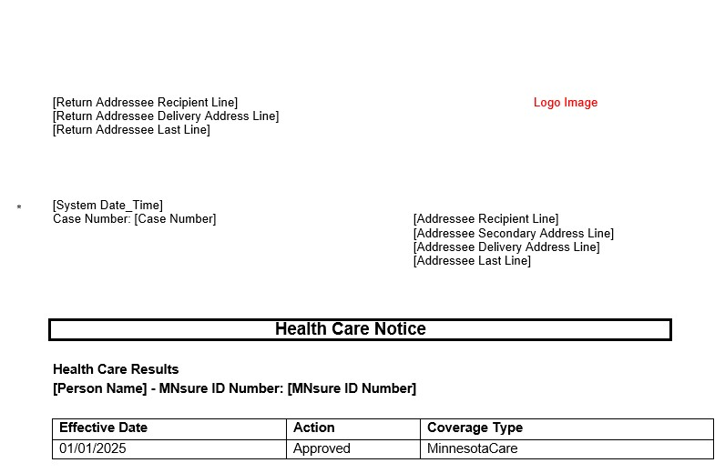
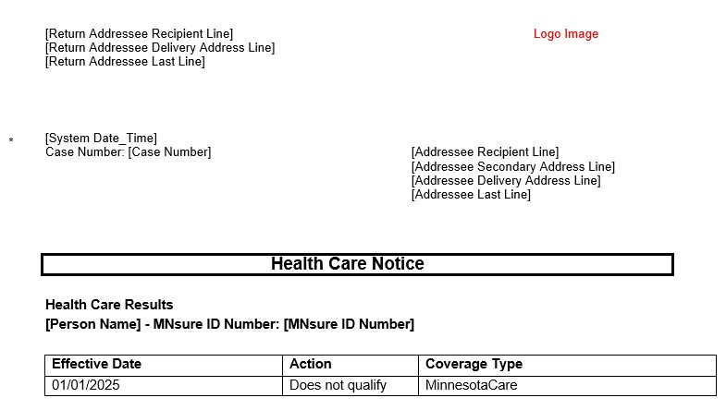
What next?
Watch your mail.
Notes:
Watch your mail.
You will receive a letter titled “Health Care Notice.” It will say either:
Approved for MinnesotaCare. Your insurance will start …
Approved for MinnesotaCare and You must give us more information.
This means you have been approved for MinnesotaCare, but we need more information or paper proof from you. The letter will tell the information you need to provide, and by when. If the information is not received by that date, your MinnesotaCare may end.
Does not qualify. This means you are ineligible for MinnesotaCare.
If other people in your household are eligible for other programs, the notice will include that eligibility information as well.

Slide 17
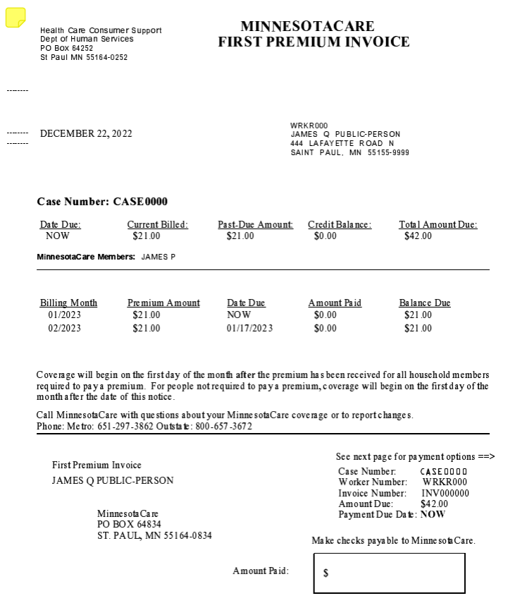
What next?
2. Pay your premium bill if you have one.
Online at payments.dhs.state.mn.us.
By phone at 800-657-3672.
By mail: MinnesotaCare PO Box 64834 St. Paul, MN 55164-0834
In person:
Elmer L. Andersen building 540 Cedar St. St. Paul, MN
Notes:
2. Pay your premium.
Once approved for MinnesotaCare, the insurance begins the month after you pay your premium if you have one. If your premium bill shows $0, skip this step.
You need to pay the premium bill by noon on the last business day of the month for the insurance to start on the first day of the next month. You can pay your bill:
Online:
Visit payments.dhs.state.mn.us.
You will need your case number, the bill/invoice number and the bill amount.
You can pay by credit card or electronic withdrawal from a checking account.
By phone
Call 800-657-3672. Choose “Option 1” for enrolled, and “Option 1” again to make a payment. You will need your case number, the bill/invoice number and the bill amount.
You can pay by credit card (VISA or MasterCard) or electronic withdrawal from a checking account.
By mail:
Allow enough time for your payment to arrive by the due date on the bill/invoice.
You can pay by check or money order. Do not mail cash. Write your case number on your check or money order.
Mail your payment with the payment stub to: MinnesotaCare PO Box 64834 St. Paul, MN 55164-0834
In person
Pay your premium at the MinnesotaCare office in downtown St. Paul Monday to Friday, 8 a.m. to 4 p.m.
Elmer L. Andersen building 540 Cedar St. St. Paul, MN
You can pay by cash, check or money order. If you pay by cash, you must have the exact amount.
County offices do not take MinnesotaCare payments.
To continue to keep MinnesotaCare, you must pay the premium bill each month. It is due around the 15th of each month. Payments received after 5:00 p.m. or on holidays or weekends will be credited the following business day.

Slide 18
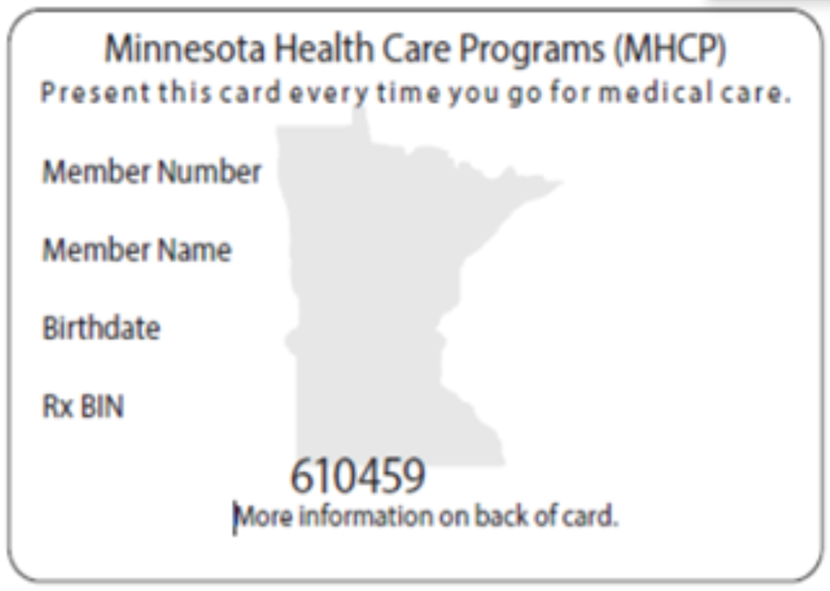
What next?
3. Look for your insurance card in the mail.
Some enrollees get their MinnesotaCare insurance through a health plan. You may also get an insurance card from one of these health plans for you or one of your family members. The health plans are:
Blue Plus
HealthPartners
Hennepin Health
Itasca Medical Care - IMCare
Medica
PrimeWest Health
South Country Health Alliance
Ucare
Notes:
3. Look for your insurance card in the mail.
Your Minnesota Health Care Programs ID card looks like this:
It means you have health insurance. Show it when you receive health care services.
If you do not receive an ID card within a couple weeks, do not submit another application. Call Health Care Consumer Support:
8 a.m. to 4 p.m., Monday-Friday 651-297-3862 or 800-657-3672 For those who speak little or no English, there are free interpreter services. TTY: Use your preferred relay service
Some enrollees get their MinnesotaCare insurance through a health plan. The health plans are:
Blue Plus
HealthPartners
Hennepin Health
Itasca Medical Care - IMCare
Medica
PrimeWest Health
South Country Health Alliance
Ucare
You may also get an insurance card from one of these health plans for you or one of your family members.

Slide 19
What next?
4. Find a health care provider.
Health plan members:
Go to doctors, dentists and other providers who are in your health plan's network for most services.
Contact your health plan at the number on the ID card they gave you for help.
Blue Plus
HealthPartners
Hennepin Health
Itasca Medical Care - IMCare
Medica
PrimeWest Health
South Country Health Alliance
UCare
Fee-for-service” members:
Go to any doctor, dentist or other provider in the fee-for-service Provider Directory at mhcpproviderdirectory.dhs.state.mn.us. These providers all accept your insurance.
You also can call the Health Care Consumer Supports call center for help finding a provider at 651-297-3862 or 800-657-3672.
Notes:
If you or a family member are enrolled in health plan member and you received another ID card tThen you or the family member must go to doctors, dentists and other providers who are in your health plan's network for most services. Contact your health plan at the number on the ID card they gave you for help.
If you are not a health plan member, you have what is called “fee-for-service” coverage. That means can go to any doctor, dentist or other provider in the fee-for-service Provider Directory. These providers all accept your insurance. You also can call the Health Care Consumer Supports call center for help finding a provider.
Learn more about “fee-for-service” coverage.

