Slide 1
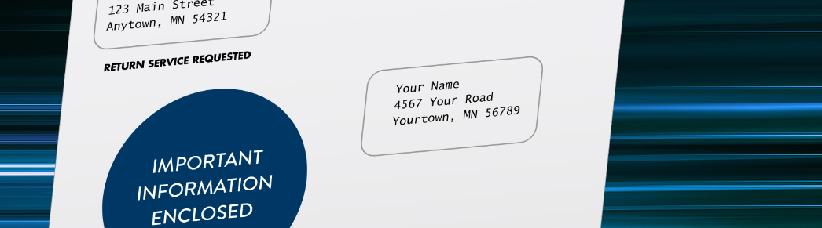

MinnesotaCare: Gobol caafimaad badan u leh dad badan

Slide 2

Waa maxay sababta caymiska caafimaadku muhiim u yahay?
Caymiska caafimaadku wuxuu kaa caawinayaa
In aad si fiican u caafimaad qabto
Inaad ku noolaato noloshaada si buuxda
Inaad horumarto
Inaad ka maaranto kharashyada badan haddii aad jirrato ama dhaawacanto
Notes:
Caymiska caafimaadku wuxuu kaa caawinayaa inaad noqoto qof sida ugu fiican u caafimaad qaba oo aad noloshaada ugu noolaato si buuxda. Wuxuu kaa caawin karaa inaad horumarto. Waxa kale oo ay kaa ilaalinaysaa kharashyada badan haddii aad jirrato ama dhaawacanto.
Qof kasta oo ku nool Minnesota wuxuu mudan yahay xasilloonida maskaxeed ee ay keenayso inaad caymis caafimaad leedahay.

Slide 3





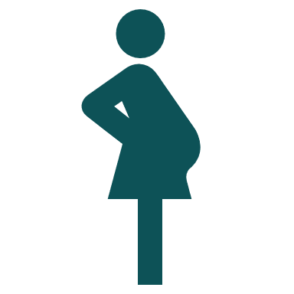






MinnesotaCare waxay bixisaa
Booqashooyinka dhakhtarka
Daryeelka Ilkaha
Daryeelka xaaladaha degdega ah
Daryeelka caafimaadka maskaxda iyo hab-dhaqanka
Baaritaannada indhaha iyo muraayadaha indhaha
Daryeelka uurka iyo caawisada xilliga umusha (doulas)
Daaweynta dhibaatada Isticmaalka Maandooriyaha
Turjumaada qoraalka ah iyo turjubaanka afka
Daawooyinka duug-duuga (Chiropractic medicine and acupuncture)
Daawooyinka iyo daawada dhakhtarku kuu qoray
Qalabka caafimaadka
Baaritaannada fayo-qabka, tallaalada
Notes:
MinnesotaCare waxay siisaa caymis caafimaad oo dhamaystiran dadka ku nool gobolka ee aan awoodin inay iska bixiyaan caymiska gaarka loo leeyahay ama caysmiska loo shaqeeyaha. Waa caymis caafimaad oo bilaash ah ama qiimo jaban oo loogu talagalay dadka aan lahayn caymis kale oo caafimaad ee ku nool Minnesota.
MinnesotaCare waxa ay jirtay muddo ka badan 30 sano. Waxaa sameeyay reer Minnesota, oo u sameeyey dadka reer Minnesota.
MinnesotaCare waxay kaa caawinaysaa inay bixiso kharashka adeegyada daryeelka caafimaadka, sida kuwa ka muuqda shaashadda (akhri liistada).

Slide 4



Yaa u qalma?
Dadka ku nool Minnesota.
Aad buuxinayso shuruudaha dakhliga.
Ayna jirin fursado kale oo caymiska caafimaadka ah.
Notes:
Dad badan oo reer Minnesota ah ayaa hadda heli kara MinnesotaCare. Laga bilaabo 2025, MinnesotaCare waxaa heli kara dadka reer Minnesota iyadoo aan loo eegayn xaaladdooda socdaalka. Dadka codsanayaa waa inay buuxiyaan xadka shuruudaha dakhliga iyo sharciyada kale.
Waxaad u qalantaa MinnesotaCare haddii aad
Aad ku nooshahay Minnesota,
Aad buuxinayso shuruudaha dakhliga.
Ayna jirin fursado kale oo caymiska caafimaadka ah. Haddii shaqadaadu ku siiso caymis caafimaad, waxa laga yaabaa inaad weli u qalanto caymis haddii caymiska shaqadaadu qaali kugu yahay.
Haddii aad buuxiso shuruudahan, waa inaad codsato.

Slide 5
Xadka dakhliga
Tirada qoyska | 1 Qof | 2 qof | 3 qof | 4 qof | 5 qof | 6 qof | 7 qof | 8 qof
Dakhliga Sannadlaha ah | $30,120 ama wax ka yar | $40,880 ama wax ka yar | $51,640 ama wax ka yar | $62,400 ama wax ka yar | $73,160 ama wax ka yar | $83,920 ama wax ka yar | $94,680 ama wax ka yar | $105,440 ama wax ka yar
Notes:
Shaxdani waxay muujinaysaa xadka dakhliga ee MinnesotaCare. Xadku wuxuu ku xiranyahay tirada dadka qoyskaaga. Tusaale ahaan, xadka dakhliga ee 1 qof waa $30,120 sannadkii. Xadka dakhliga ee qoyska afar qof ka kooban waa $62,400.
Dadka codsanaya MinnesotaCare waa inay keenaan caddayn ah inay buuxiyeen shuruudaha xadka dakhliga. Caddaynta waxaa ka mid ahaan kara jeega dabadiisa ama bayaanka xisaabaadka bangiga. Ama dadka codsanaya ayaa waxay soo saxeexi karaan dukumeenti sharci ah oo caddaynaya inay buuxiyeen xadka dakhliga.

Slide 6
Waa imisa kharashka qiimaheedu: Khidmada billaha ah ee caymiska
Tirada qoyska | 1 Qof | 2 qof | 3 qof | 4 qof | 5 qof | 6 qof | 7 qof | 8 qof | Khidmada billaha ah ee caymiska
Dakhliga Sannadlaha ah | Ilaa $24,095 | Ilaa $32,703 | Ilaa $41,311 | Ilaa $49,919 | Ilaa $58,527 | Ilaa $67,135 | Ilaa $75,743 | Ilaa $84,351 | $0
Dakhliga Sannadlaha ah | Ilaa $25,601 | Ilaa $34,747 | Ilaa $43,893 | Ilaa $53,039 | Ilaa $62,185 | Ilaa $71,331 | Ilaa $80,477 | Ilaa $89,623 | $4*
Dakhliga Sannadlaha ah | Ilaa $27,107 | Ilaa $36,791 | Ilaa $46,475 | Ilaa $56,159 | Ilaa $65,843 | Ilaa $75,527 | Ilaa $85,211 | Ilaa $94,895 | $9*
Dakhliga Sannadlaha ah | Ilaa $28,613 | Ilaa $38,835 | Ilaa $49,057 | Ilaa $59,279 | Ilaa $69,501 | Ilaa $79,723 | Ilaa $89,945 | Ilaa $100,167 | $15*
Dakhliga Sannadlaha ah | Ilaa $30,119 | Ilaa $40,879 | Ilaa $51,639 | Ilaa $62,399 | Ilaa $73,159 | Ilaa $83,919 | Ilaa $94,679 | Ilaa $105,439 | $21*
*Ku dhufo tirada dadka qoyska ee ka diiwaangashan MinnesotaCare si aad u wadarta guud ee biilka.
Notes:
Qaar ka mid ah xubnaha MinnesotaCare ayaa bixiya biil bille ah, oo loo yaqaano khidmada caymiska (premium), oo lagu bixinayo caymiskooda. Qadarka lacagta biilku wuxuu ku xiran yahay dakhligaaga, tirada qoyska iyo tirada xubnaha qoyska ee u diiwaangashan barnaamijka.
Dadka qaarkood loogaama baahna in ay bixiyaan khidmada billaha ah ee caymiska:
Carruurta ka yar 21.
Hindida Maraykanka iyo Dhaladka Alaska iyo qoysaskooda.
Xubnaha milatariga iyo qoysaskooda 12 bilood haddii ay xaq u yeeshaan 24 bilood gudahood ka dib markay dhammeeyeen howlgalkooda shaqo.
Kadib markaad codsato, waxaa laguu sheegi doonaa inaad u qalanto MinnesotaCare. Markaa kadib waxaad u baahan tahay inaad bixiso khidmadahaaga caymiska bisha ugu horraysa si uu u bilaabmo caymiskaagu.
Khidmadaha billaha ah si ku meel gaar ah ayaa hoos loogu dhigay illaa Diseembar 2025 sababtoo ah sharciga federaalka inta lagu jiro COVID-19. Dad badan ayaan bixin doonin wax khidmad ah bishii ilaa inta ay khidmaduhu ku soo laabanayaan heerkoodii hore 2026.

Slide 7
Waa imisa kharashka qiimaheedu: qayb bixinta (copays)
Qayb bixinta MinnesotaCare:
$0 daryeelka ka hortaga ah, sida baaritaannada sannadlaha ah, baarista kansarka iyo tallaallada
$0 qalliinka bukaan-socodka
$0 qalab caafimaadka ee muddada waaraya, sida kuraasta curyaanka, qalabka lugaynta, qalabka ogsijiinta ama qalabka dhiiga lagu baaro ee sonkorowga
$0 booqashooyinka dhakhtarka ilkaha
$0 daawooyinka caafimaadka dhimirka
$25 oo ah dawooyinka astaanta magaca leh ama $10 dawooyinka aan astaanta magaca lahayn oo ah ugu badnaan $70 bishii
$28 booqashooyinka dhakhtarka
$100 booqashooyinka qolka gurmadka degdega ah ($0 qayb bixin haddii booqashada ER ay keento jiifinta cusbitaalta)
$250 isbitaal jiifinta bukaanka
$45 booqashada adeegyada raajada, sida X-ray-ga
$10 halkii xabo ee muraayadaha indhaha
Dadka qaarkood loogaama baahna in ay bixiyaan qayb bixin:
  Carruurta ka yar 21 sano
  Haweenka uurka leh
  Hindida Maraykanka ee ka diiwaangashan qabiil federaalku aqoonsan yahay
  Hindida Maraykanka ee ka hela adeegyada bixiyaha daryeelka caafimaadka Hindida ama u soo gudbinta ka timid Adeegyada Caafimaadka Hindida (IHS) Adeegyada Caafimaadka Qandaraaska ah
Notes:
Qaar ka mid ah xubnaha MinnesotaCare ayaa waxaa looga baahanyahay inay bixiyaan qayb ka mid ah biilasha kharashka caafimaadka. Wadaagista kharashka waxaa la dhahaa qayb bixin. Waa qaddar cayiman oo aad jeebkaaga ka bixiso oo lagu bixinayo adeega daryeel caafimaad oo gaar ah.
Dadka qaarkood loogaama baahna in ay bixiyaan qayb bixin:
Carruurta ka yar 21 sano
Haweenka uurka leh
Hindida Maraykanka ee ka diiwaangashan qabiil federaalku aqoonsan yahay
Hindida Maraykanka ee ka hela adeegyada bixiyaha daryeelka caafimaadka Hindida ama u soo gudbinta ka timid Adeegyada Caafimaadka Hindida (IHS) Adeegyada Caafimaadka Qandaraaska ah
MinnesotaCare waxay bixisaa adeegyo badan oo kala duwan oo loogu talagalay daryeelka ka hortaga, daryeelka caadiga ah, daryeelka takhasuska khaaska ah iyo daryeelka xaaladaha degdega ah. Inta badan adeegyadu ma laha qayb bixin (copay). Tusaale ahaan:
$0 daryeelka ka hortaga ah, sida baaritaannada sannadlaha ah, baarista kansarka iyo tallaallada
$0 qalliinka bukaan-socodka
$0 qalab caafimaadka ee muddada waaraya, sida kuraasta curyaanka, qalabka lugaynta, qalabka ogsijiinta ama qalabka dhiiga lagu baaro ee sonkorowga
$0 booqashooyinka dhakhtarka ilkaha
$0 daawooyinka caafimaadka dhimirka
Qayb bixinta MinnesotaCare:
$25 oo ah dawooyinka astaanta magaca leh ama $10 dawooyinka aan astaanta magaca lahayn oo ah ugu badnaan $70 bishii
$28 booqashooyinka dhakhtarka
$100 booqashooyinka qolka gurmadka degdega ah ($0 qayb bixin haddii booqashada ER ay keento jiifinta cusbitaalta)
$250 isbitaal jiifinta bukaanka
$45 booqashada adeegyada raajada, sida X-ray-ga
$10 halkii xabo ee muraayadaha indhaha
Waxaad si toos ah daryeel bixiyahaaga u siinaynaa lacagta qayb bixintaada. Daryeel bixiyeyaasha qaarkood waxay u baahan yihiin inaad bixiso qayb bixinta kahor inta aadan helin adeegyada caafimaadka.
Kuwani waa kharashyada kaliya ee xubnaha MinnesotaCare ay ku bixiyaan adeegyada ku jira caymiska. Xubnaha MinnesotaCare ma leh kharashka kharash wadaaqa. (Kharash wadaagu (deductibles) waa qaddar lagaa rabo oo ay tahay inaad jeebka ka bixiso kahor inta aan caymisku bixinin biilashaada caafimaadka.)

Slide 8

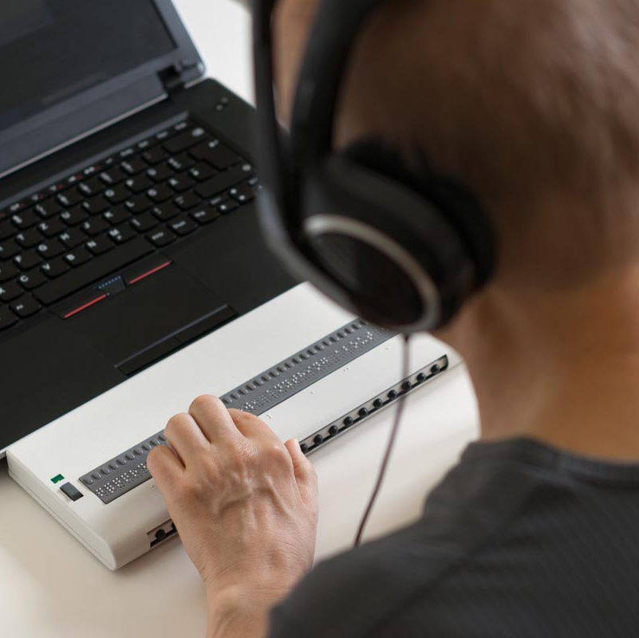

Sida loo codsado
Waad codsan kartaa 24/7/365
Caawin fool-ka-fool ah oo aad ka hesho hage ka socda bulshadaada
Khadka internetka
Foomka warqadda ah
Notes:
Waxaad ka codsan kartaa MinnesotaCare wakhti kasta inta lagu jiro sanadka. Ma jiro wakhti kama dambays ah oo ay tahay in lagu codsado Ma jiraan wax xaddidaad ah oo ku saabsan tirada dadka lagu diiwaangelin karo.
Dooro habka ugu fudud ee aad ku dalban karto:
Caawin fool-ka-fool ah: Ka hel caawimo bilaash ah khabiir ka tirsan bulshadaada. Hagaha (Navigators) ayaa ku tustusi doona habka. Waxay sidoo kale ka jawaabayaan su'aalahaaga. Ka hel hage ku hadla luqadaada mnsure.org/free-help. Waxaad sidoo kale soo wici kartaa 651-539-2099 ama 855-366-7873 si aad luqadaada caawimo ugu hesho.
Khadka Internetka: Ka codso internetka mnsure.org. Waxaad u baahan doontaa inaad isu diiwaangeliso akoon, ama aad gasho haddii aad horeba ugu lahayd akoon. Xasuusin: Haddii carruurtaada ama xubnaha kale ee qoysku ay hore ugu diiwaangashanaayeen Medical Assistance ama MinnesotaCare, ha soo dirin codsi cusub. Wac hage (navigator) ama wac county (degmadaada) si aad caawimo u hesho.
Foomka warqadda ah: Buuxi arjiga warqadda ah, oo u soo dir degmadaada.Waxaad arjiyada ka heli kartaa websaydkeena mn.gov/dhs/MinnesotaCare, adiga oo adeegsanaya hage (navigator) ama xafiiska degmadaada.
Si lagaaga caawiyo in MinnesotaCare kuuguu bilaabato sida ugu dhakhsaha badan:
Si dhammaystiran u buuxi arjigaaga.
Ka soo jawaab codsiyada macluumaad dheeraad ah isla markiiba.
Bixi lacagtaada khidmada ah isla markiiba.

Slide 9
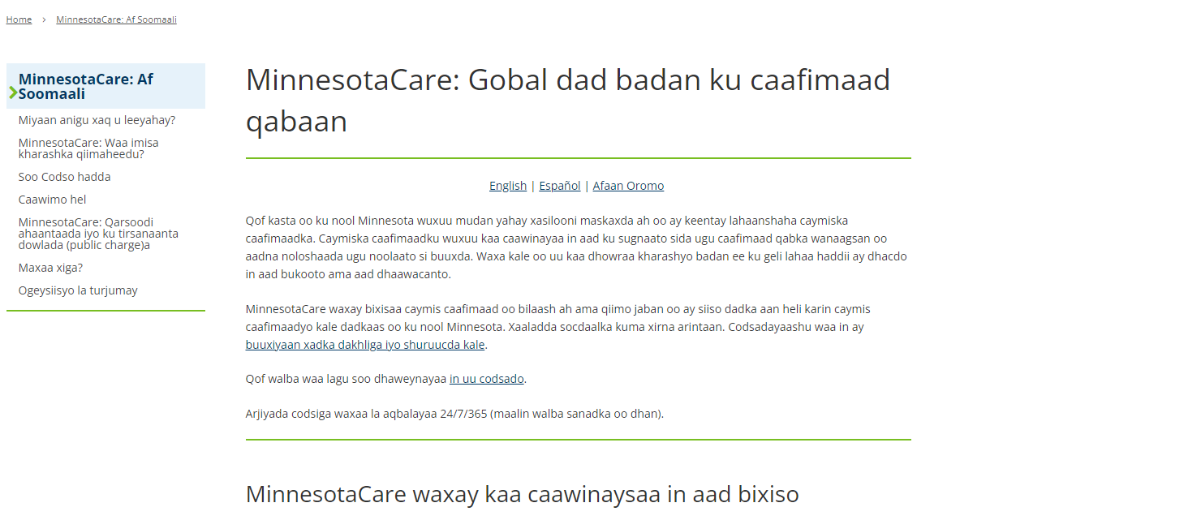
Khayraadkaaga laga heli karo khadka internetka: mn.gov/dhs/MinnesotaCare
Notes:
Waxaan u samaynay hal meel oo loogu talagalay dhammaan MinnesotaCare oo ah mn.gov/dhs/MinnesotaCare. Websaydkani waxa uu ku siinayaa dhammaan macluumaadka aad u baahantahay waxaana lagu heli karaa Ingiriisi, Isbaanish, Soomaali iyo Oromo.
Wax ka baro xeerarka u qalmitaanka iyo inta ay tahay inaad ka bixiso caymiskaaga iyo adeegyada daryeelka caafimaadka. Waxaad ku codsan kartaa khadka internetka ama waxaad caawimo u heli kartaa arjigaaga. Ogoow waxa dhici doona kadib marka laguu ogolaado MinnesotaCare. Hak jawaabaha su'aalaha badanaa la isweydiiyo. Oo hel nuqul la soo turjumay oo ah ogeysiisyada ee laga yaabo in laguugu soo diro boostada.

Slide 10
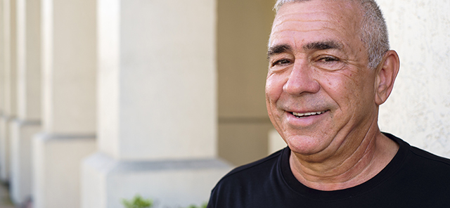
Tusaalooyinka dadka laga yaabo inay u xaq u yeeshaan
Carlos waa 67 jir.
Waxa uu ku noolyahay Minnesota kadib markii uu soo galay Maraykanka ogolaansho la'aan. Ma haysto waraaqaha socdaalka.
Ma guursanin, caruurna ma leh.
Wuxuu sameeyaa $1,500 bishii, ama $18,000 sanadkii.
Caymis ma haysto, shaqadiisuna ma bixiso caymis caafimaad.
Talaabada xigta: Buuxi arji.
Notes:
Tusaalooyinka dadka laga yaabo inay u xaq u yeeshaan
Carlos waa 67 jir.
Waxa uu ku noolyahay Minnesota kadib markii uu soo galay Maraykanka ogolaansho la'aan. Ma haysto waraaqaha socdaalka.
Ma guursanin, caruurna ma leh.
Wuxuu sameeyaa $1,500 bishii, ama $18,000 sanadkii.
Caymis ma haysto, shaqadiisuna ma bixiso caymis caafimaad.
Talaabada xigta: Buuxi arji Booqo mn.gov/dhs/MinnesotaCare si aad u hesho hage (navigator) kaa caawiya inaad codsato caawimo fool ka fool ah oo bilaash ah. Ama baro sida loogu codsado internetka ama hel arjiyada warqada si aad u daabacato

Slide 11
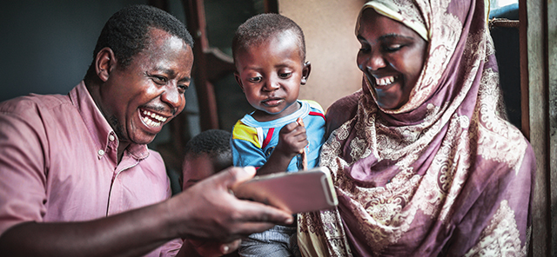
Tusaalooyinka dadka laga yaabo inay u xaq u yeeshaan
Fatima iyo Ibrahim labaduba waa 45 jir.
Waxay ku noolyihiin Minnesota midkoodna ma haysto waraaqaha socdaalka.
Waa xaas oo waxay leeyihiin laba carruur ah, kuwaas oo labaduba ah muwaadiniin u dhashay Maraykanka oo qaatacaymiska Gargaarka Caafimaadka.
Dakhliga qoyskoodu waa $60,000 sanadkii.
Loo shaqeeyayaashooda ma bixiyo caymis caafimaad oo ay awoodaan.
Talaabada xigta: Wac hage (navigator) ama wac degmadaada si aad ugu codsato caymiska Fatima iyo Ibrahim. Ha ka codsan khadka internetka – waxa aad horeba u haysataa kiis kaaga furan nidaamka caymiska ee carruurtaada.
Notes:
Tusaalooyinka dadka laga yaabo inay u xaq u yeeshaan
Fatima iyo Ibrahim labaduba waa 45 jir.
Waxay ku noolyihiin Minnesota midkoodna ma haysto waraaqaha socdaalka.
Waa xaas oo waxay leeyihiin laba carruur ah, kuwaas oo labaduba ah muwaadiniin u dhashay Maraykanka oo qaatacaymiska Gargaarka Caafimaadka.
Dakhliga qoyskoodu waa $60,000 sanadkii.
Loo shaqeeyayaashooda ma bixiyo caymis caafimaad oo ay awoodaan.
Talaabada xigta: Wac hage (navigator) ama wac county (degmadaada) si aad u codsato caymiska waalidka. Ha ka codsan khadka internetka – waxa aad horeba u haysataa kiis kaaga furan nidaamka caymiska ee carruurtaada.
Dadka qaarkooda oo dhawaan u qalmay MinnesotaCare waxa laga yaabaa inay leeyihiin xubin qoyskooda dhow ah sida ilmo oo hore uga diiwaangashan MinnesotaCare. Ama ilmaha ayaa waxaa laga yaabaa in horeba uga diiwangashanyihiin Gargaarka Caafimaadka, kaas oo ah barnaamij kale oo caymis ah oo loogu talagalay dadka Minnesota ee dakhligoodu yar yahay.
Marka qof raba MinnesotaCare uu leeyahay xubin dhow qoyska ka mid ah, sida xaas ama ilmo, kaas oo horay ugu diiwaangashan Gargaarka Caafimaadka ama MinnesotaCare, qofku uma baahna inuu soo dirsado arjiga MinnesotaCare. Waxay horeba u leeyihiin kiis loo bilaabay. Qofku waa inuu la xiriiro degmadooda ama hagaha si ay u helaan caawimo. Sababtoo ah waxaan horeyba u haynaynaa macluumaadka aasaasiga ah ee ku saabsan qoyskooda, uma baahna inay soo bixiyaan arji dhammaystira oo macluumaadkooda ah. Oo dhab ahaantiina soo diritaanka arji kale ayaa waxay keeni kartaa cillado iyo dib u dhac ku yimaada helitaanka caymiska. Mar labaad, dadka leh xubin qoys ka mid ah oo dhow oo ku jira Gargaarka Caafimaadka waa inayna soo dirin arjiga MinnesotaCare. Waa inayna sidoo kale ku codsan khadka internetka. Waa inay la xiriiraan degmadooda ama hagaha si ay u helaan caawimo.

Slide 12

Tusaalooyinka dadka laga yaabo inay u xaq u yeeshaan
Paul iyo Nadine labaduba waa 26 jir.
  Waxay ku noolyihiin Minnesota midkoodna ma haysto waraaqaha socdaalka.
  Waa xaas oo waxay leeyihiin laba carruur ah, kuwaas oo labaduba ah Muwaadin Maraykan ah.
  Waxay sannadkii helaan 62,000 oo Dollar.
  Loo shaqeeyayaashooda ma bixiyaan caymis caafimaad oo ay u awoodi karaan qoyskoodu. Ma jiro qof qoyska ka mid ah oo haysta caymis caafimaad.
  Tallaabada xigta: U buuxi arjiga dhammaan afarta xubnood ee qoyska.
Notes:
Tusaalooyinka dadka laga yaabo inay u xaq u yeeshaan
Paul iyo Nadine labaduba waa 26 jir.
Waxay ku noolyihiin Minnesota midkoodna ma haysto waraaqaha socdaalka.
Waa xaas oo waxay leeyihiin laba carruur ah, kuwaas oo labaduba ah Muwaadin Maraykan ah.
Waxay sannadkii helaan 62,000 oo Dollar.
Loo shaqeeyayaa shoodu ma bixiyaan caymis caafimaad oo ay awoodi karaan qoyskoodu.
Tallaabada xigta: U buuxi arjiga dhammaan afarta xubnood ee qoyska.

Slide 13

Tusaalooyinka dadka laga yaabo inay u xaq u yeeshaan
Amari waa 21 jir.
Waxay ku noolyihiin Minnesota kadib markii ay Maraykanka ku yimaadeen fiiso, taas oo ka dhacday. Dalka ayay iska sii joogeen oo ma haystaan warqadaha socdaalka.
Waxay sameeyaan $2,500 bishii, ama $30,000 sannadkii.
Talaabada xigta: Buuxi arji
Notes:
Tusaalooyinka dadka laga yaabo inay u xaq u yeeshaan
Amari is 21.
They live in Minnesota after coming to the United States on a Visa, which has expired. They stayed in the country and have no immigration papers.
They make $2,500 a month, or $30,000 a year.
Next step: Complete an application .

Slide 14

Tusaalooyinka dadka laga yaabo inay u xaq u yeeshaan
Ana waa 35 jir.
  Waxay ku nooshahay Minnesota waana qof ku jirta xaalada Tallaabada dib loo dhigay ee ku imaatinka carruurnimada (Deferred Action for Childhood Arrivals - DACA).
  Mayna guursanin, caruurna ma leh.
  Wuxuu sameeyaa $2,500 bishii, ama $30,000 sanadkii.
  Caymis ma haysato, shaqadeeduna ma bixiso caymis caafimaad.
  Talaabada xigta: Dadka qaata DACA waxay xaq u lahaayeen MinnesotaCare laga soo bilaabo 2017 oo waxay raacaan nidaam codsi oo gooni ah (different application process).
Notes:
Tusaalooyinka dadka laga yaabo inay u xaq u yeeshaan
Ana waa 35 jir.
Waxay ku nooshahay Minnesota waana qof ku jirta xaalada Tallaabada dib loo dhigay ee ku imaatinka carruurnimada (Deferred Action for Childhood Arrivals - DACA).
Mayna guursanin, caruurna ma leh.
Wuxuu sameeyaa $2,500 bishii, ama $30,000 sanadkii.
Caymis ma haysato, shaqadeeduna ma bixiso caymis caafimaad.
Talaabada xigta: Dadka qaata DACA waxay xaq u lahaayeen MinnesotaCare laga soo bilaabo 2017 oo waxay raacaan nidaam codsi oo gooni ah (different application process).

Slide 15

Tusaalooyinka dadka laga yaabo inay u xaq u yeeshaan
Maria waa 32 jir.
Waxay ku nooshahay Minnesota waxayna codsatay magangalyo, laakiin weli mayna helin ogolaanshaha shaqada.
Waxay haysataa ilmo 10 jir ah oo arjigiisa magangelyadu uu sugitaan ku jiro wax ka yar 180 maalmood.
Iyadu hadda iskeed ayey u shaqeysataa oo waxay qaadataa $27,000 sanadkii.
Iyada iyo ilmaheedu ma haystaan caymis caafimaad.
Talaabada xigta: Buuxi arji
Marka Maria hesho ogolaanshaha shaqada oo codsiga magangelyo ee ilmaheeda la sugayey 180 maalmood, waa in ay soo ogaysiiso isbeddelada kooxda Taageerada Daryeelka Caafimaadka ee Macmiilka ee Waaxda Adeegyada Aadanaha. Ilmaheedu waxa laga yaabaa in uu u qalmo Gargaarka Caafimaadka. Waxay kala shaqayn kartaa gobolka si ay ilmaheeda uga soo bedesho MinnesotaCare una soo wareejiso Gargaarka Caafimaadka haddii ay u qalanto.
Notes:
Tusaalooyinka dadka laga yaabo inay u xaq u yeeshaan
Maria waa 32 jir.
Waxay ku nooshahay Minnesota waxayna codsatay magangalyo, laakiin weli mayna helin ogolaanshaha shaqada.
Waxay haysataa ilmo 10 jir ah oo arjigiisa magangelyadu uu sugitaan ku jiro wax ka yar 180 maalmood.
Iyadu hadda iskeed ayey u shaqeysataa oo waxay qaadataa $27,000 sanadkii.
Iyada iyo ilmaheedu ma haystaan caymis caafimaad.
Talaabada xigta: Buuxi arji.
Marka Maria hesho ogolaanshaha shaqada oo codsiga magangelyo ee ilmaheeda la sugayey 180 maalmood, waa in ay soo ogaysiiso isbeddelada kooxda Taageerada Daryeelka Caafimaadka ee Macmiilka (Health Care Consumer Support team) ee Waaxda Adeegyada Aadanaha. Ilmaheedu waxa laga yaabaa in uu u qalmo Gargaarka Caafimaadka. Waxay kala shaqayn kartaa gobolka si ay ilmaheeda uga soo bedesho MinnesotaCare una soo wareejiso Gargaarka Caafimaadka haddii ay u qalanto.

Slide 16
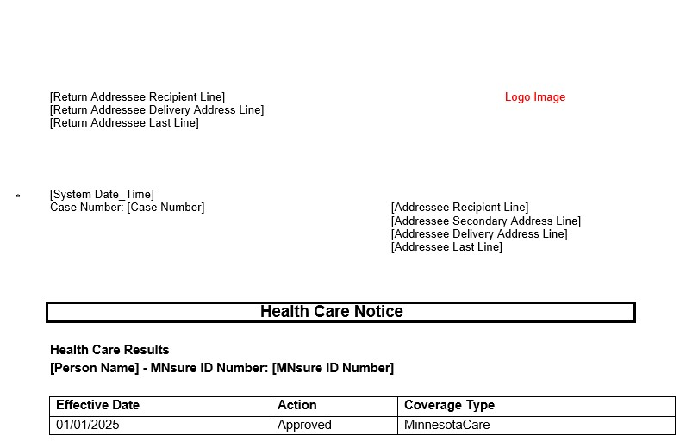
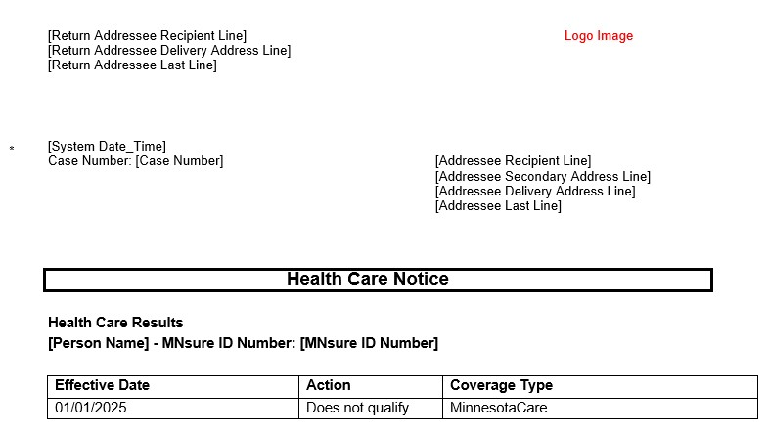
Maxaa xiga?
Boostada ka sug
Notes:
Boostada ka sug
Waxaa laguu soo diri doonaa warqad ciwaankeedu yahay “Health Care Notice.” ("Ogaysiiska Daryeelka Caafimaadka." Waxaa ku qornaan doona kuwan midkood:
Ogolaanshaha MinnesotaCare. Caymiskaaga ayaa bilaaban doona…
Ogolaanshaha MinnesotaCare waana inaad na soo siiso macluumaad dheeraad ah.
Tan macnaheedu waxay ka dhigan tahay in laguu ogolaaday MinnesotaCare, laakiin waxaan kaaga baahanahay macluumaad dheeraad ah ama warqad caddayn ah. Warqaddu waxay sheegi doontaa macluumaadka aad u baahan tahay inaad na soo siiso, iyo goorta lagaa rabo. Haddii macluumaadka aan la helin taariikhdaas lagaa rabo, MinnesotaCare waxaa laga yaabaa inay kaa dhammaato.
Uma qalantid Tani waxay ka dhigan tahay inaadan u qalmin MinnesotaCare.
Haddii dadka kale ee qoyskaaga ka tirsan ay u qalmaan barnaamijyo kale, ogeysiiska waxaa ku jiri doona macluumaadka u-qalmitaankaas sidoo kale.

Slide 17
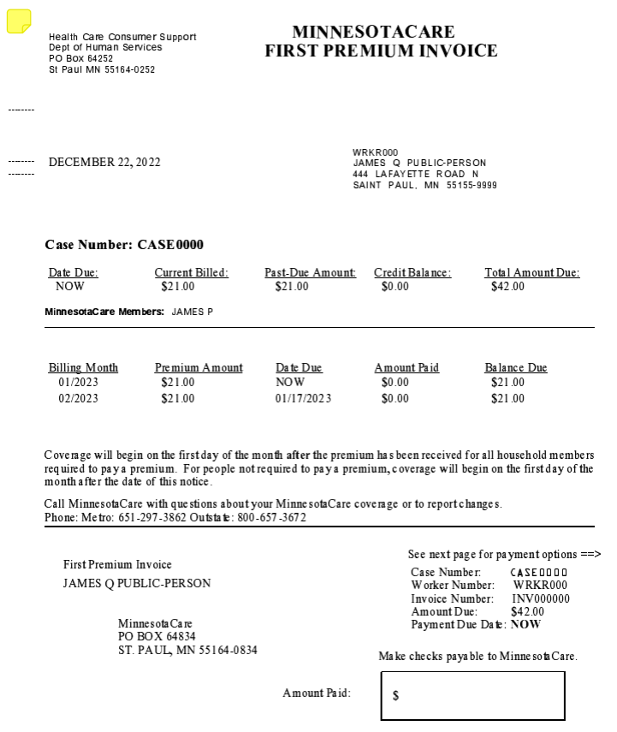
Maxaa xiga?
2. Bixi khidmada billaha ah ee caymiska haddii ay jirto.
Khadka internetka iyaga oo lagu bixnayo payments.dhs.state.mn.us
Telefoon ahaan 800-657-3672.
Boostada iyaga oo lagu soo dirayo:
  MinnesotaCare
PO Box 64834
St. Paul, MN 55164-0834
Qof ahaan in aad u timaado
  Elmer L. Andersen building
  540 Cedar St.
  St. Paul, MN
Notes:
2. Bixi lacagtaada khidmada ah.
Marka laguu ogolaado MinnesotaCare, caymisku wuxuu bilaabmayaa bisha ka dambaysa marka aad bixiso lacagta caymiska haddii aad khidmad bixinayso. Haddii khidmadaada caymisku tahay $0, ka gudub talaabadan.
Waxaad u baahan tahay inaad ku bixiso biilka caymiska ugu dambayn duhurkii maalinta ganacsiga ee ugu dambeysa bisha si uu caymisku u bilowdo maalinta ugu horeysa ee bisha xigta. Waxaad ku bixin kartaa khidmada biilkaaga:
Khadka internetka:
Booqo payments.dhs.state.mn.us.
Waxaad u baahan doontaa lambarka kiiskaaga, biilka/lambarka qaansheegta iyo cadadka lacagta biilka.
Waxaad ku bixin kartaa bangiga ama si elektarooniga ah in akoonka jeekinka looga saaro.
Telefoon ahaan
Soo Wac 800-657-3672. Dooro “Option 1” ("xulashada 1" oo ah dadka diiwaangashan, iyo “Option 1” ("xulashada 1" mar kale si aad lacagta u bixiso. Waxaad u baahan doontaa lambarka kiiskaaga, biilka/lambarka qaansheegta iyo cadadka lacagta biilka.
Waxaad ku bixin kartaa kaarka bangiga (VISA ama MasterCard) ama kala bixitaanka elektarooniga ah ee akoonka jeekinka.
Boostada:
U ogolow wakhti ku filan in lacag bixintaadu ku gaarto taariikhda kama dambaysta ah ee biilka/ qaansheegta.
Waxaad ku bixin kartaa jeeg ama money order. Boostada ha ku soo dirin lacag kaash ah. Ku soo qor lambarka kiiskaaga jeega ama money order-ka.
Soo dir lacag bixintaada oo ay la socota warqadda codsiga lacag bixinta:
MinnesotaCare
PO Box 64834
St. Paul, MN 55164-0834
Qof ahaan in aad u timaado
Ku bixi khidmadaada xafiiska MinnesotaCare ee ku yaalla downtown-ka magaalada St. Paul Isniinta ilaa Jimcaha, 8 a.m. illaa 4 p.m.
Elmer L. Andersen building
540 Cedar St.
St. Paul, MN
Waxaad ku bixin kartaa lacag kaash ah, jeeg ama money order. Haddii aad ku bixinayso lacag kaash ah, waa inaad haysataa qaddarka lacagta ee saxda ah.
Xafiisyada degmadu ma aqbalaan lacagaha MinnesotaCare.
Si aad u sii hayso MinnesotaCare, waa inaad bixisa biilka bishii bil kasta. Waxaa lagaa rabaa 15-ka bisha bil kasta. Khidmadaha caymiska ee la helo wixii ka dambeeya 5:00 p.m. ama feestada ah ama maalmaha dhamaadka asbuuca waxaa loo xisaabin doonaa maalinta shaqada ee soo socota.

Slide 18
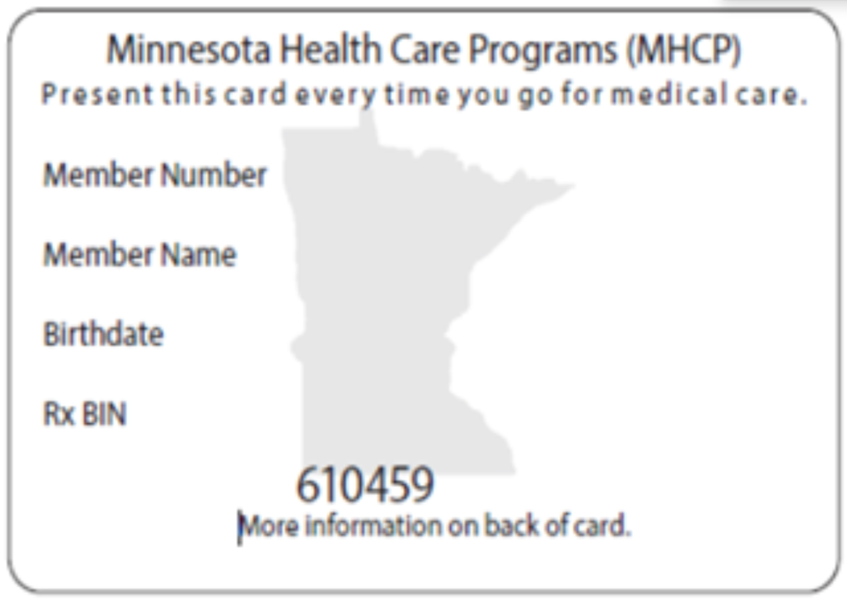
Maxaa xiga
3. Boostada ka filo kaarkaaga caymiska.
Dadka isdiiwaangeliyay qaarkood ayaa waxay caymiskooda MinnesotaCare ku helaan qorshe caymis caafimaad. Waxa kale oo laga yaabaa in ay kaarka caymiska ku siiyaan mid ka mid ah qorshayaashan caymiska caafimaadku adiga ama mid ka mid ah xubnaha qoyskaaga. Qorshayaasha caymiska caafimaadku waa:
    Blue Plus
    HealthPartners
    Hennepin Health
    Itasca Medical Care - IMCare
    Medica
    PrimeWest Health
    South Country Health Alliance
    Ucare
Notes:
3. Boostada ka filo kaarkaaga caymiska.
KaaRkaaga aqoonsiga Barnaamijyada Daryeelka Caafimaadka EE Minnesota wuxuu u egyahay sidan:
Taas macnaheedu waxa weeyaan inaad leedahay caymis caafimaad. Tus marka aad hesho adeegyada daryeelka caafimaadka.
Haddii aadan ku helin kaarka aqoonsiga dhowr toddobaad gudahood, ha soo dirin arji kale. Wac Taageerada Macmiilka ee Daryeelka Caafimaadka:
8 a.m. illaa 4 p.m., Isniinta - Jimcaha 651-297-3862 ama 800-657-3672. Dadka ku hadla Ingiriisi yar ama aan Ingiriisi ku hadlin, waxaa jira adeegyo turjubaan oo bilaash ah. Dadka ku hadla Ingiriisi yar ama aan Ingiriisi ku hadlin, waxaa jira adeegyo turjubaan oo bilaash ah. TTY: Isticmaal adeegyada gudbinta (relay) ee aad doorbidayso.
Dadka isdiiwaangeliyay qaarkood ayaa waxay caymiskooda MinnesotaCare ku helaan qorshe caymis caafimaad. Qorshayaasha caymiska caafimaadku waa:
Blue Plus
HealthPartners
Hennepin Health
Itasca Medical Care - IMCare
Medica
PrimeWest Health
South Country Health Alliance
Ucare
Waxa kale oo laga yaabaa in ay kaarka caymiska ku siiyaan mid ka mid ah qorshayaashan caymiska caafimaadku adiga ama mid ka mid ah xubnaha qoyskaaga.

Slide 19
Maxaa xiga
4. Hel dhakhtar daryeel bixiye caafimaad.
Xubnaha qorshaha caymiska caafimaadka:
Waxay u tagi karaan dhakhaatiirta, dhakhaatiirta ilkaha iyo daryeel bixiyeyaasha kale ee ku jira shabakada qorshahaaga caafimaadka si ay u helaan adeegyada badankooda.
Kala xiriir qorshahaaga caymiska caafimaadka lambarka ku yaalla kaarka aqoonsiga ee ay ku siiyeen si aad u hesho caawimo.
    Blue Plus
    HealthPartners
    Hennepin Health
    Itasca Medical Care - IMCare
    Medica
    PrimeWest Health
    South Country Health Alliance
    UCare
Xubnaha adeegyada khidmada leh.
Waxay u tagi karaan dhakhtar kasta, dhakhtarka ilkaha ama daryeel bixiye kasta oo ku jira mhcpproviderdirectory.dhs.state.mn.us Daryeel bixiyeyaashan dhamaantood way aqbalayaan caymiskaaga.
Waxa kale oo aad wici kartaa Health Care Consumer Supports (Xarunta Wicida Taageerada Macaamiisha ee Daryeelka Caafimaadka) si aad u hesho adeeg bixiye 651-297-3862 ama 800-657-3672..
Notes:
Haddii adiga ama xubin qoyska ka mid ah aad ka diiwaangashantihii mid ka mid ah qorshayaasha caymiska caafimaadka oo aad heshay kaar kale oo aqoonsi ah, markaas, waa inaad u tagto dhakhaatiirta, dhakhaatiirta ilkaha iyo daryeel bixiyeyaasha kale ee ku jira shabakada qorshahaaga caafimaadka si aad u hesho adeegyada badankooda. Kala xiriir qorshahaaga caymiska caafimaadka lambarka ku yaalla kaarka aqoonsiga ee ay ku siiyeen si aad u hesho caawimo.
Haddii aadan xubin ka ahayn qorshaha caymiscaafimaad, waxaad haysataa waxa loo yaqaano caymiska “fee-for-service” ("adeega khidmada leh"). Taas macnaheedu waa in aad u tagi karto dhakhtar kasta, dhakhtarka ilkaha ama daryeel bixiye kasta oo ku jira Diiwaanka Bixiyaha adeega khidmada leh (Provider Directory). Daryeel bixiyeyaashan dhamaantood way aqbalayaan caymiskaaga. Waxa kale oo aad wici kartaa Health Care Consumer Supports (Xarunta Wicida Taageerada Macaamiisha ee Daryeelka Caafimaadka) si aad u hesho adeeg bixiye.
Ogoow wax badan oo ku saabsan caymiska fee-for-service” coverage ("adeega khidmada leh").

